Slide 1
Logistic function

Slide 2
A logistic function or logistic curve is a common "S" shape (sigmoid curve).

Slide 3
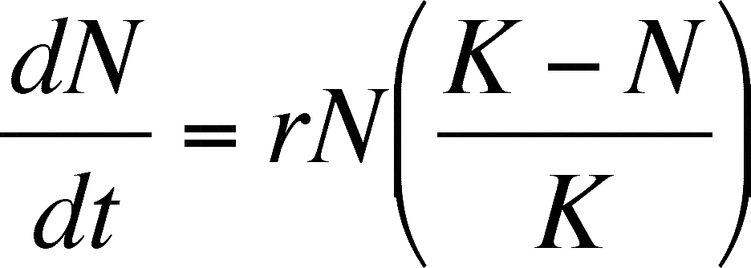

Slide 5
