Slide 1
Limit (continued), application of derivative (continued), integral, application of integral, differential equations, series, statistical calculus

Slide 2
Limit (continued)
The indeterminate forms are 0/0, ∞/∞, 1∞
Question:
Give indeterminate forms.

Slide 3
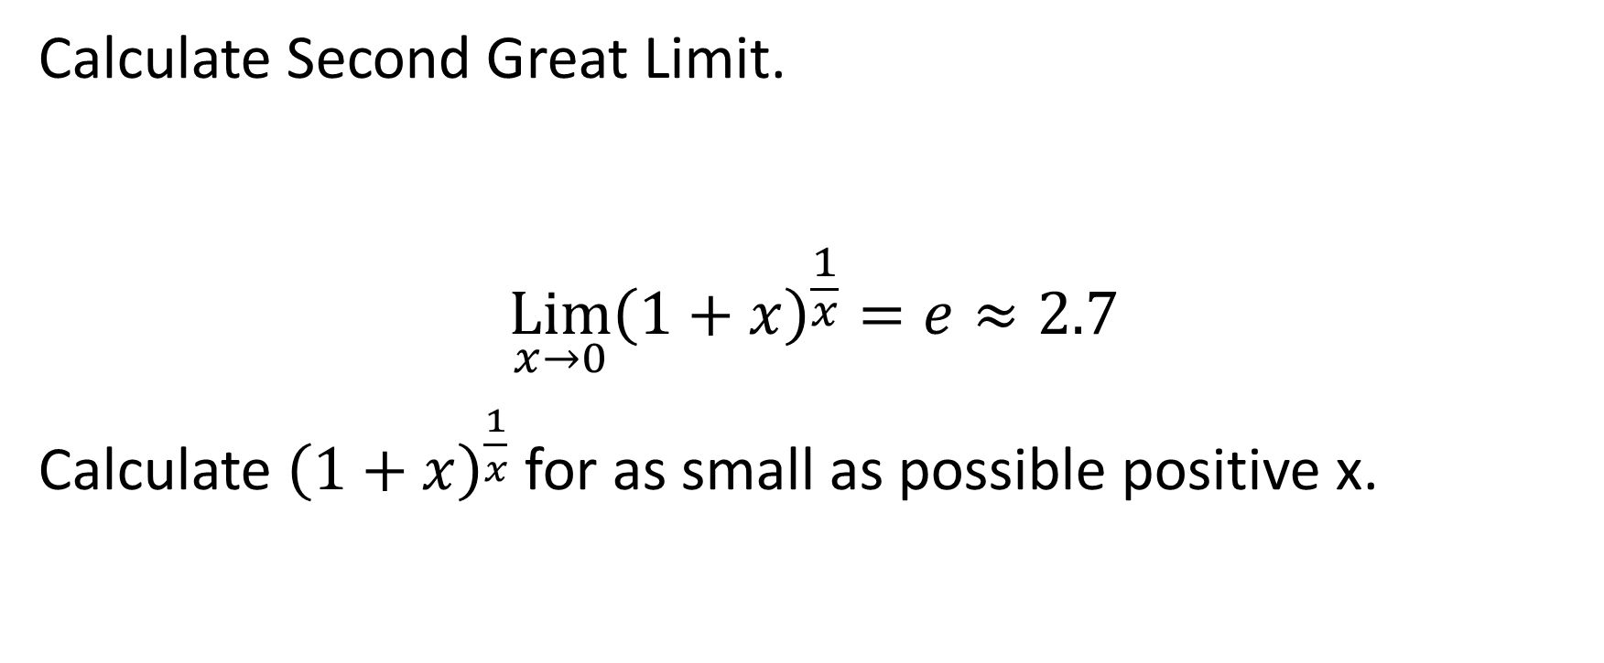
Calculate Second Great Limit.
$$\underset{x→0}{Lim}{{\left(1+x\right)}^{\frac{1}{x}}=e≈2.7}$$
Calculate ${\left(1+x\right)}^{\frac{1}{x}}$ for as small as possible positive x.

Slide 4
Question:
Explain L’Hopital rule.
Calculate First Great Limit using L’Hopital rule.

Slide 5
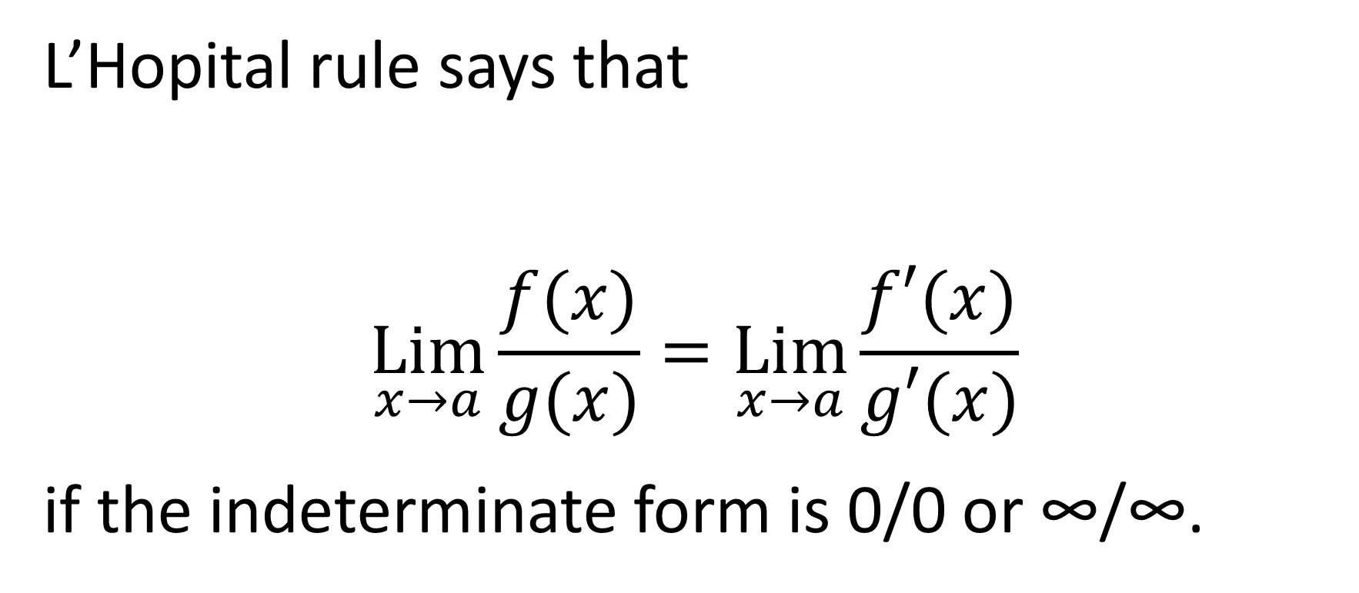
L’Hopital rule says that
$$\underset{x→a}{Lim}{\frac{f(x)}{g(x)}}=\underset{x→a}{Lim}{\frac{f′(x)}{g′(x)}}$$
if the indeterminate form is 0/0 or ∞/∞.

Slide 6
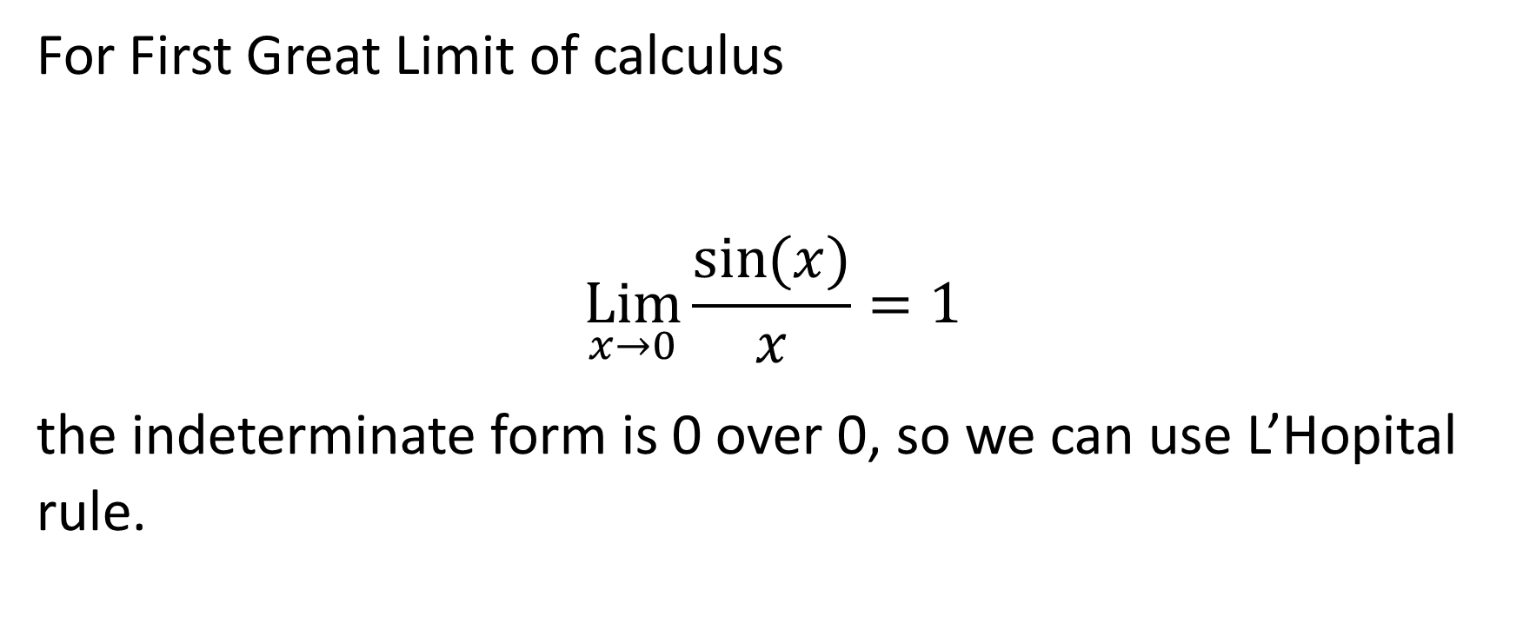
For First Great Limit of calculus
$$\underset{x→0}{Lim}{\frac{\sin{(x)}}{x}}=1$$
the indeterminate form is 0 over 0, so we can use L’Hopital rule.

Slide 7

$$\underset{x→0}{Lim}{\frac{\sin{(x)}}{x}}=\lim_{x→0}{\frac{\cos{(x)}}{1}}=1$$

Slide 8
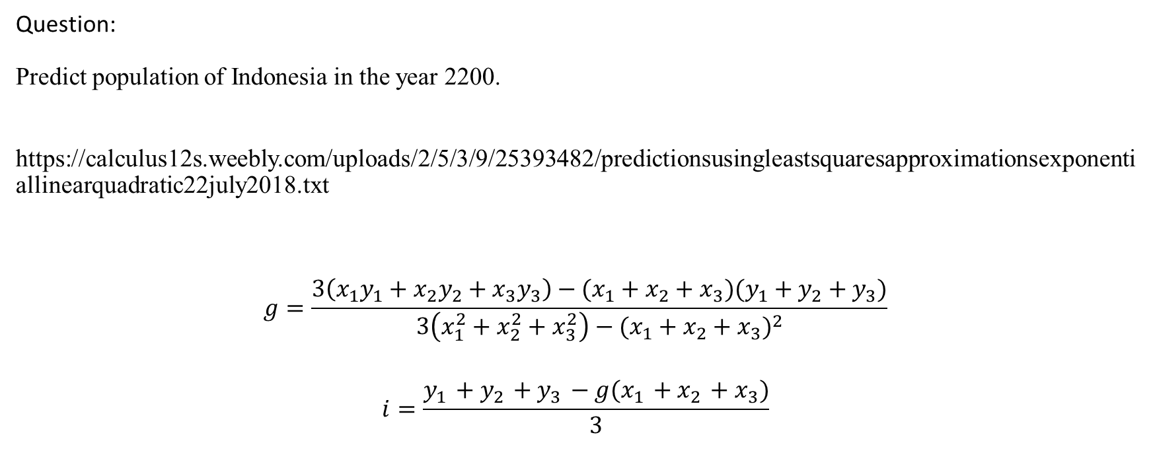
Application of derivatives (continued)
Question:
Predict population of Indonesia in the year 2200.
https://calculus12s.weebly.com/uploads/2/5/3/9/25393482/predictionsusingleastsquaresapproximationsexponentiallinearquadratic22july2018.txt
$$g=\frac{3\left(x_{1}y_{1}+x_{2}y_{2}+x_{3}y_{3}\right)−(x_{1}+x_{2}+x_{3})(y_{1}+y_{2}+y_{3})}{3\left(x_{1}^{2}+x_{2}^{2}+x_{3}^{2}\right)−{(x_{1}+x_{2}+x_{3})}^{2}}$$
$$i=\frac{y_{1}+y_{2}+y_{3}−g(x_{1}+x_{2}+x_{3})}{3}$$

Slide 9
Question:
When will the population of Indonesia be 0?
https://calculus12s.weebly.com/uploads/2/5/3/9/25393482/predictionsusingleastsquaresapproximationsexponentiallinearquadratic22july2018.txt

Slide 10

Question:
Prove
$$g=\frac{3\left(x_{1}y_{1}+x_{2}y_{2}+x_{3}y_{3}\right)−(x_{1}+x_{2}+x_{3})(y_{1}+y_{2}+y_{3})}{3\left(x_{1}^{2}+x_{2}^{2}+x_{3}^{2}\right)−{(x_{1}+x_{2}+x_{3})}^{2}}$$
$$i=\frac{y_{1}+y_{2}+y_{3}−g(x_{1}+x_{2}+x_{3})}{3}$$

Slide 11
Derivative (continued)
Partial derivative is derivative with respect to one variable, considering all the other variables as constants.

Slide 12
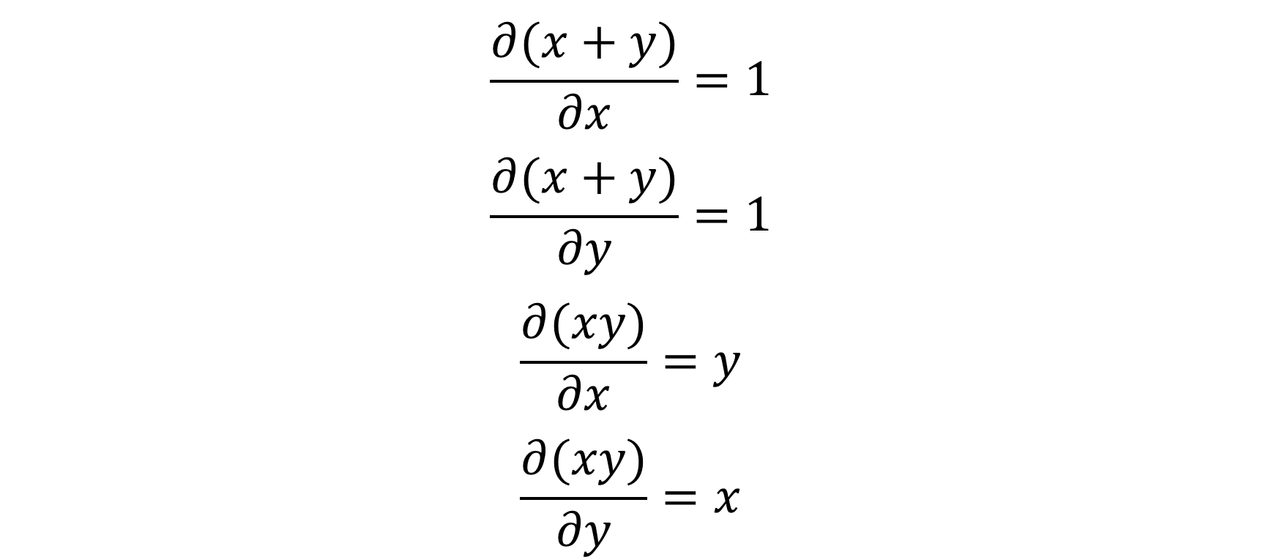
$$\frac{∂(x+y)}{∂x}=1$$
$$\frac{∂(x+y)}{∂y}=1$$
$$\frac{∂(xy)}{∂x}=y$$
$$\frac{∂(xy)}{∂y}=x$$

Slide 13
Question:
Find partial derivatives.
m₂ = 0: x + y
m₂ = 1: xy

Slide 14
Total derivative is when we calculate the sum of all the partial derivatives.

Slide 15

$$\frac{d(x+y)}{dx}=\frac{∂(x+y)}{∂x}\frac{dx}{dx}+\frac{∂(x+y)}{∂y}\frac{dy}{dx}=1+\frac{dy}{dx}$$

Slide 16

$$\frac{d(xy)}{dx}=\frac{∂(xy)}{∂x}\frac{dx}{dx}+\frac{∂(xy)}{∂y}\frac{dy}{dx}=y+x\frac{dy}{dx}$$

Slide 17
Question:
Calculate total derivative.
m₂ = 0: x + y
m₂ = 1: xy

Slide 18
Implicit function
Implicit function cannot be easily resolved with respect to y = f(x).
To calculate derivative of implicit function, we take total derivative of the implicit function and express y’ from this equation.

Slide 19
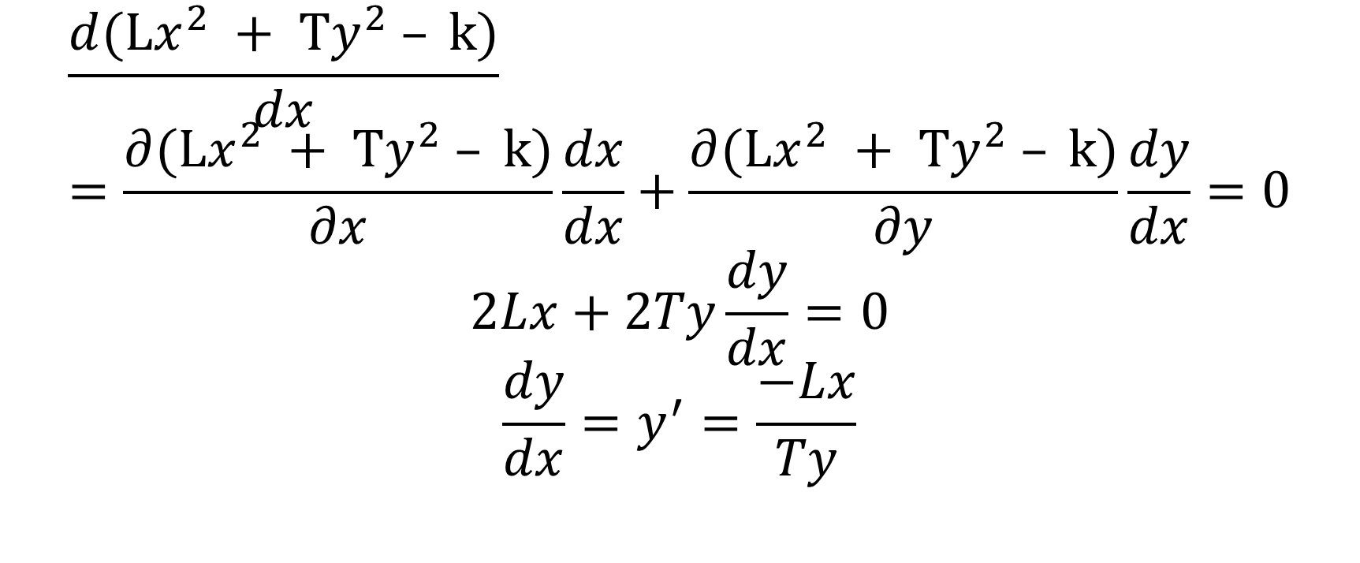
$$\frac{d(Lx^{2} + Ty^{2} – k)}{dx}=\frac{∂(Lx^{2} + Ty^{2} – k)}{∂x}\frac{dx}{dx}+\frac{∂(Lx^{2} + Ty^{2} – k)}{∂y}\frac{dy}{dx}=0$$
$$2Lx+2Ty\frac{dy}{dx}=0$$
$$\frac{dy}{dx}=y^{′}=\frac{−Lx}{Ty}$$

Slide 20
Question:
Find implicit function derivative. Lx² + Ty² – k = 0

Slide 21
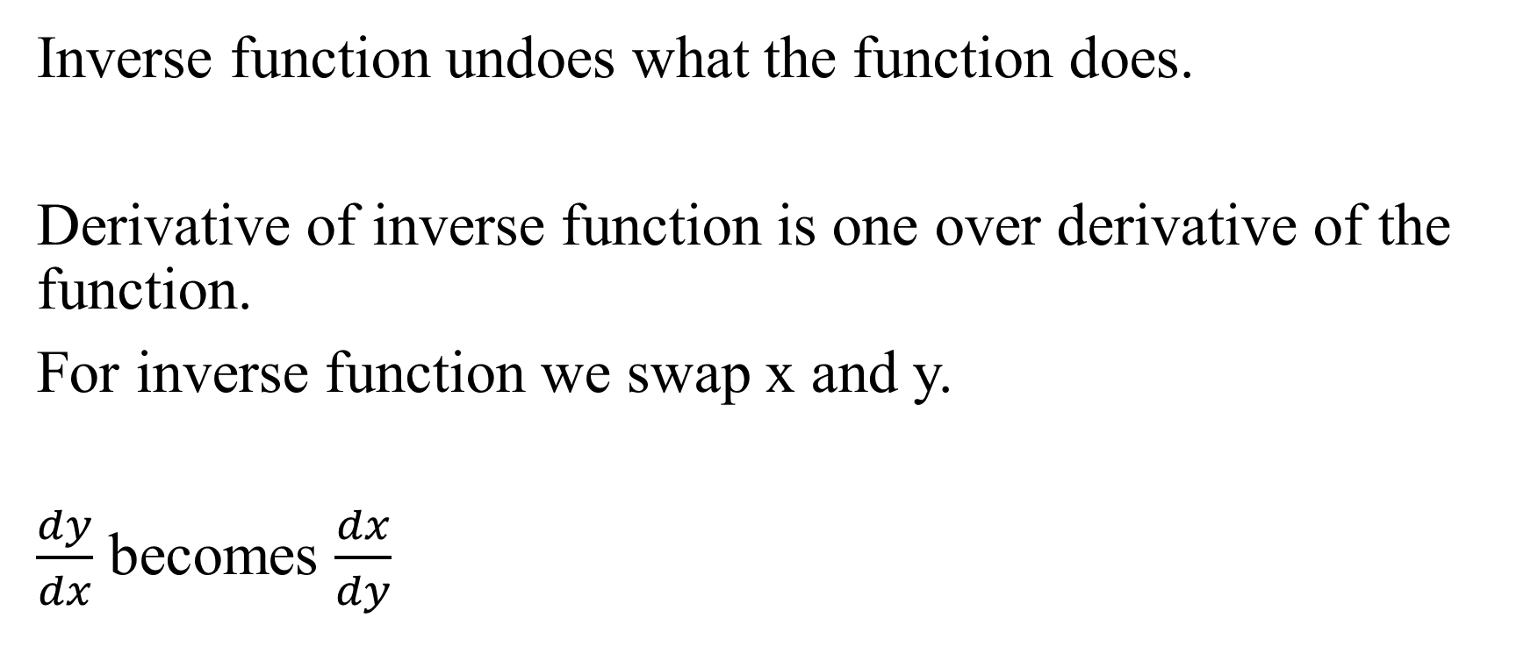
Inverse function
Inverse function undoes what the function does.
Derivative of inverse function is one over derivative of the function.
For inverse function we swap x and y.
$\frac{dy}{dx}$ becomes $\frac{dx}{dy}$

Slide 22

$$\frac{d(Tx + L)}{dx}=T$$
Derivative of inverse function is 1/T.

Slide 23
Question:
Calculate inverse function derivative y = Tx + L.

Slide 24

Integral
Integral $\int_{a}^{b}{f\left(x\right)dx}$is the limit of the sum $\underset{ h→0}{\int_{a}^{b}{f\left(x\right)dx}= Lim}{\sum_{k=1}^{n}{f\left(kh\right)h}}$
$$h=\frac{b−a}{n}$$
interval [a, b] is divided into n parts, each of each is h in length.

Slide 25
Integral is a non-local operation, which means that integral is more difficult to calculate than derivative.

Slide 26
Irrational numbers are continuous.
Rational numbers are discrete.

Slide 27

Calculate:
a. $\int_{0}^{T}{r\left(x\right)dx}$
b. $\int_{0}^{s}{i\left(x\right)dx}$
c. $\int_{s−5}^{s}{\left\lfloor x\right\rfloor dx}$
d. $\int_{k −5}^{k }{\left\lceil x\right\rceil dx}$
e.$\int_{1/s}^{1}{\tan\left(x\right)dx}$
f. $\int_{1/T}^{1}{\cot\left(x\right)dx}$
$r\left(x\right)$= 1 if $x$ is a rational number, $r\left(x\right)$= 0 if $x$ is an irrational number.
$i\left(x\right)$= 0 if $x$ is a rational number, $i\left(x\right)$= 1 if $x$ is an irrational number.

Slide 28

$$\int{x^{T}dx}$$
$$\int{\sin\left(Tx\right)} dx$$
$$\int_{0}^{1}{x^{T}dx}$$
$$\int_{0}^{1}{\sin\left(Tx\right)dx}$$

Slide 29

$$\int{e^{Tx}dx}$$

Slide 30

$$\int_{0}^{1}{e^{Tx}dx}$$

Slide 31
Methods of integration
Do integration by substitution sin(Tx).

Slide 32
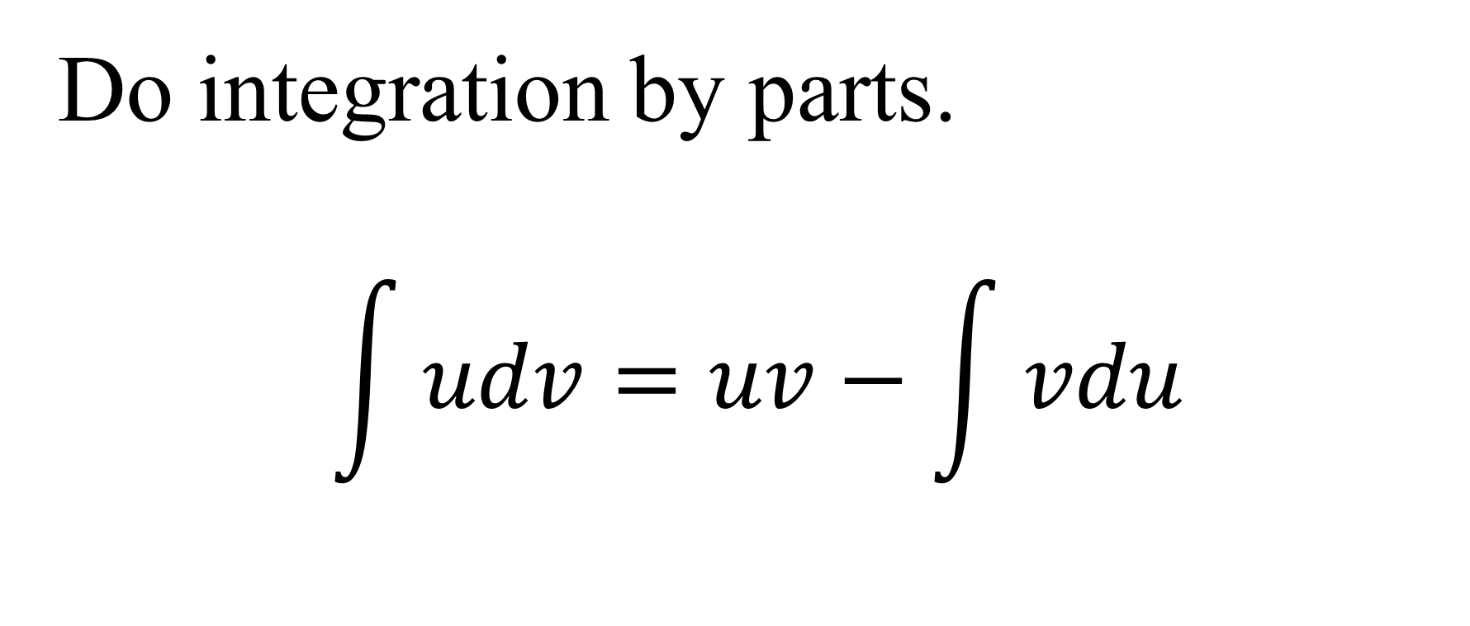
Do integration by parts.
$$\int{udv=uv−\int{vdu}}$$

Slide 33
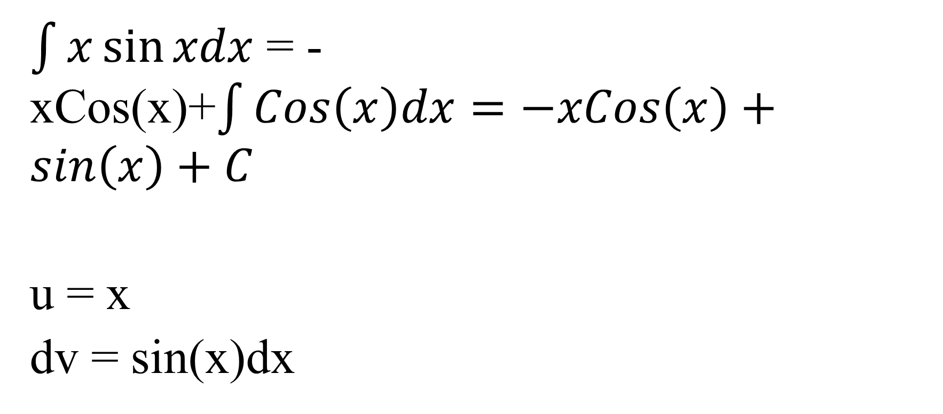
$\int{x\sin{xdx}}$ = -xCos(x)+$\int{Cos\left(x\right)dx=−xCos\left(x\right)}+sin\left(x\right)+C$
u = x
dv = sin(x)dx

Slide 34
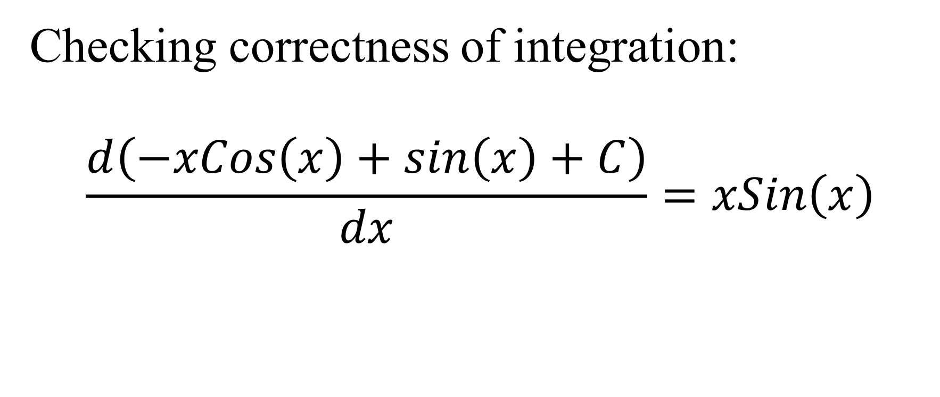
Checking correctness of integration:
$$\frac{d\left(−xCos\left(x\right)+sin\left(x\right)+C\right)}{dx}=xSin\left(x\right)$$

Slide 35

Find $\int{f\left(x\right)dx}$ using Heaviside method.

Slide 36

$$f\left(x\right)=\frac{L_{1}x^{2}+m_{1}x+n_{1}}{\begin{aligned}\left(x−a_{1}\right)\left(x−b_{1}\right)\left(x−c_{1}\right) \\ \end{aligned}}=\frac{A_{1}}{\left(x−a_{1}\right)}+\frac{B_{1}}{\left(x−b_{1}\right)}+\frac{C_{1}}{\left(x−c_{1}\right)}$$

Slide 37
L₁ = L = m₁₀
m₁ = m = m₃₅
n₁ = s
a₁ = a = m₂₅
b₁ = T
c₁ = e = m₈

Slide 38
https://calculus17.weebly.com/uploads/7/7/9/0/77906190/heaviside_cover-up_method_14jan2019.txt

Slide 39
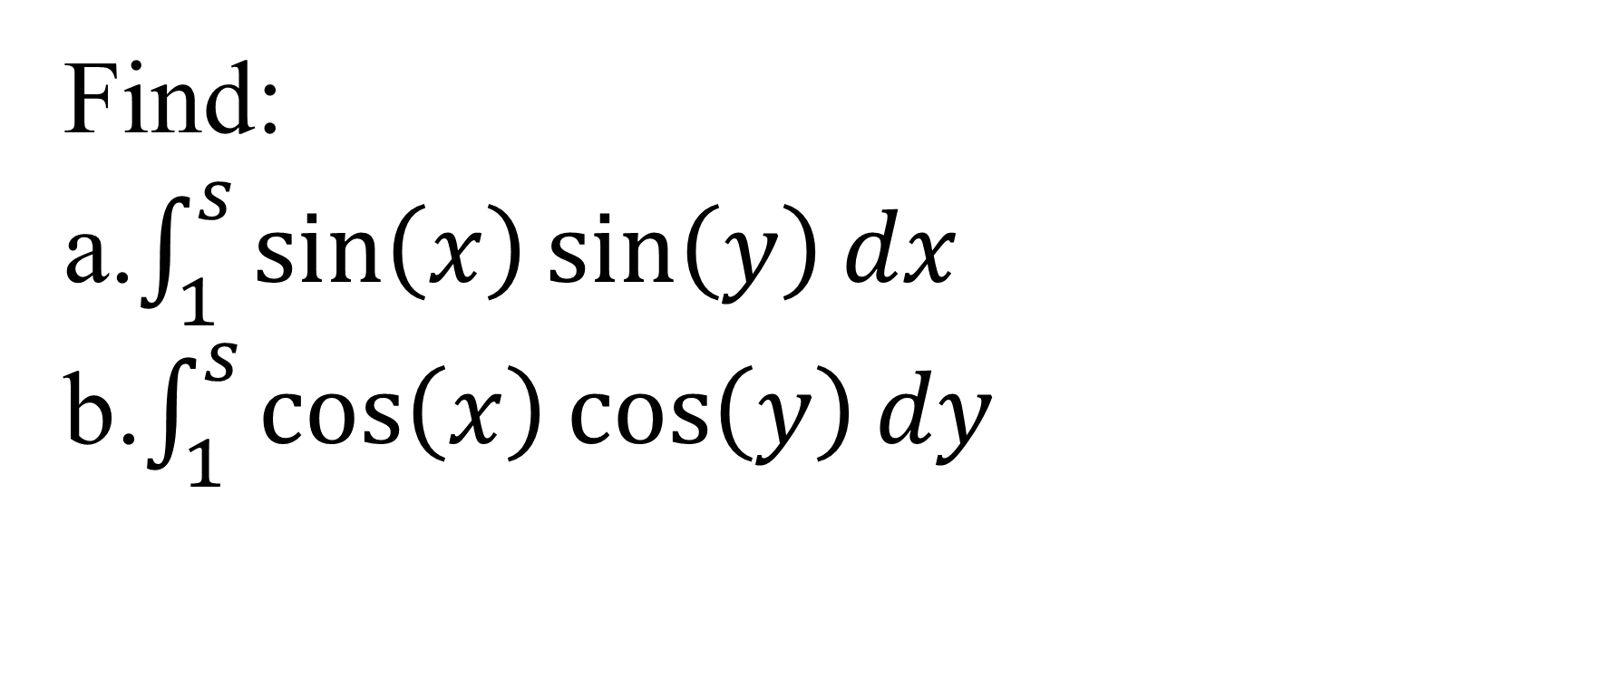
Find:
a.$\int_{1}^{s}{\sin\left(x\right)\sin\left(y\right)dx}$
b.$\int_{1}^{s}{\cos\left(x\right)\cos\left(y\right)dy}$

Slide 40
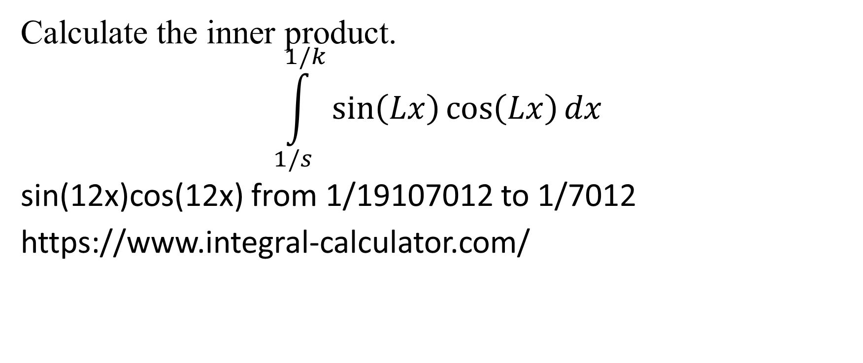
Calculate the inner product.
$$\int_{1/s}^{1/k}{\sin\left(Lx\right)\cos\left(Lx\right)dx}$$
sin(12x)cos(12x) from 1/19107012 to 1/7012
https://www.integral-calculator.com/

Slide 41
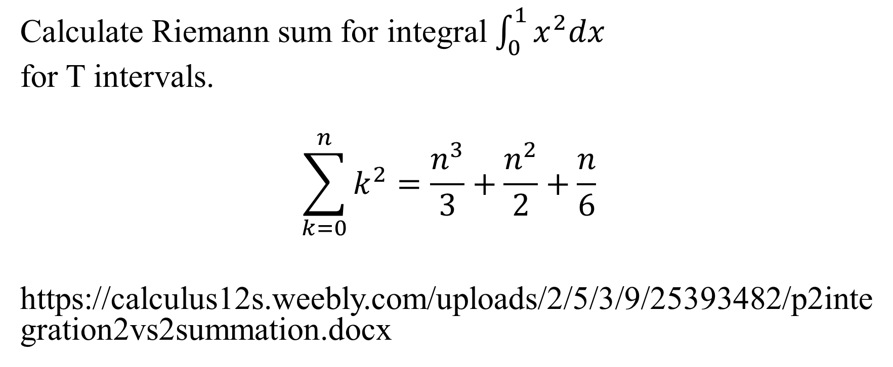
Calculate Riemann sum for integral $\int_{0}^{1}{x^{2}dx}$
for T intervals.
$$\sum_{k=0}^{n}{k^{2}=\frac{n^{3}}{3}+\frac{n^{2}}{2}}+\frac{n}{6}$$
https://calculus12s.weebly.com/uploads/2/5/3/9/25393482/p2integration2vs2summation.docx

Slide 42

Numerical integration
Give the integration formulas:
m₄ = 0: Left and right rectangles
$$\int_{a}^{b}{f\left(x\right)dx≈h\sum_{k=0}^{n−1}{f\left(a+kh\right)}}$$

Slide 43

$$h=\frac{b−a}{n}$$

Slide 44
https://calculus12s.weebly.com/uploads/2/5/3/9/25393482/left-rectangles-numerical_integration-method.txt

Slide 45

$$\int_{a}^{b}{f\left(x\right)dx≈h\sum_{k=1}^{n}{f\left(a+kh\right)}}$$

Slide 46
https://calculus12s.weebly.com/uploads/2/5/3/9/25393482/right-rectangles-numerical-integration-method.txt

Slide 47
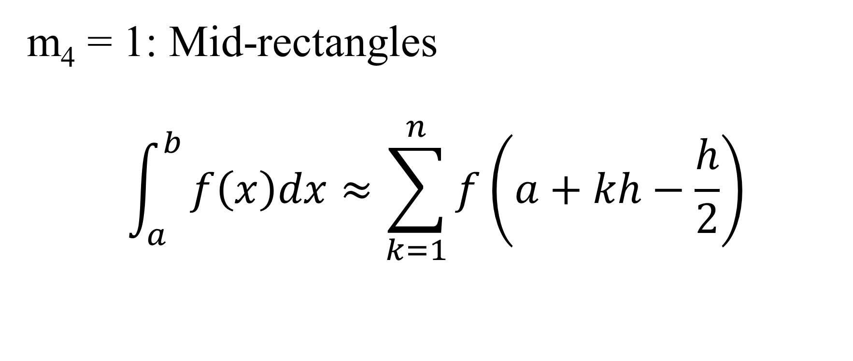
m₄ = 1: Mid-rectangles
$$\int_{a}^{b}{f\left(x\right)dx≈\sum_{k=1}^{n}{f\left(a+kh−\frac{h}{2}\right)}}$$

Slide 48
https://calculus12s.weebly.com/uploads/2/5/3/9/25393482/mid-rectangles-numerical-integration-method.txt

Slide 49

m₄ = 2: Trapezoidal rule
$$\int_{a}^{b}{f\left(x\right)dx≈\frac{\left(b−a\right)}{2n}\sum_{k=1}^{n}{\left(f(h\left(k−1\right)+f(hk)\right)}}$$

Slide 50
https://calculus12s.weebly.com/uploads/2/5/3/9/25393482/trapezoidal-rule-numerical-integration-method.txt

Slide 51

m₄ = 3: Simpson rule
$$\int_{a}^{b}{f\left(x\right)dx≈\frac{h}{3}}\left(f\left(a\right)+2\sum_{k=1}^{\frac{n}{2}−1}{f\left(2kh\right)+4\sum_{k=1}^{\frac{n}{2}}{f\left((2k−1)h\right)}+}f\left(b\right)\right)$$

Slide 52
https://calculus12s.weebly.com/uploads/2/5/3/9/25393482/simpson-rule-numerical-integration-method.txt

Slide 53

integration error bounds
m₄ = 0: Left and right rectangles
Rectangular rule, right or left rectangular rule:
We calculate the largest possible error of numerical calculating of the integral I = $\int_{a}^{b}{f\left(x\right)dx}$
using the rectangular rule I_{R}.

Slide 54
We approximate our function f(x) with a constant at each small subinterval.
We must find the inequality for D = |I – I_{R}|.

Slide 55
From 0 to h:
The straight line S(x) = sx + i goes through the points (x₀, y₀) and (x₁, y₁).

Slide 56
s = (y₁ – y₀)/h, i = y₀. Here we take x₀ = 0 and x₁ = h.
d₁ = |(y₁ – y₀)h/2 + hy₀ – hy₀| = |(y₁ – y₀)h/2| ≤ m₁h²/2.

Slide 57
Here m₁ is absolute maximum derivative f’(x) at the small interval [0, h].
S’(x) = s = (y₁ – y₀)/h.

Slide 58
Substituting h = (b – a)/n, we get d₁ ≤ m₁(b - a)²/(2n²) ≤ M₁(b - a)²/(2n²).
There n small subintervals like [0, h].

Slide 59
D ≤ nM₁(b - a)²/(2n²)
D = |I – I_{R}| ≤ M₁(b - a)²/(2n)
Here M₁ is absolute maximum derivative f’(x) at the whole interval [a, b].

Slide 60
https://calculus12s.weebly.com/uploads/2/5/3/9/25393482/rectangularruleintegrationerrorbounds.docx

Slide 61
m₄ = 1: Mid-rectangles
Mid rectangles rule integration error bounds:

Slide 62
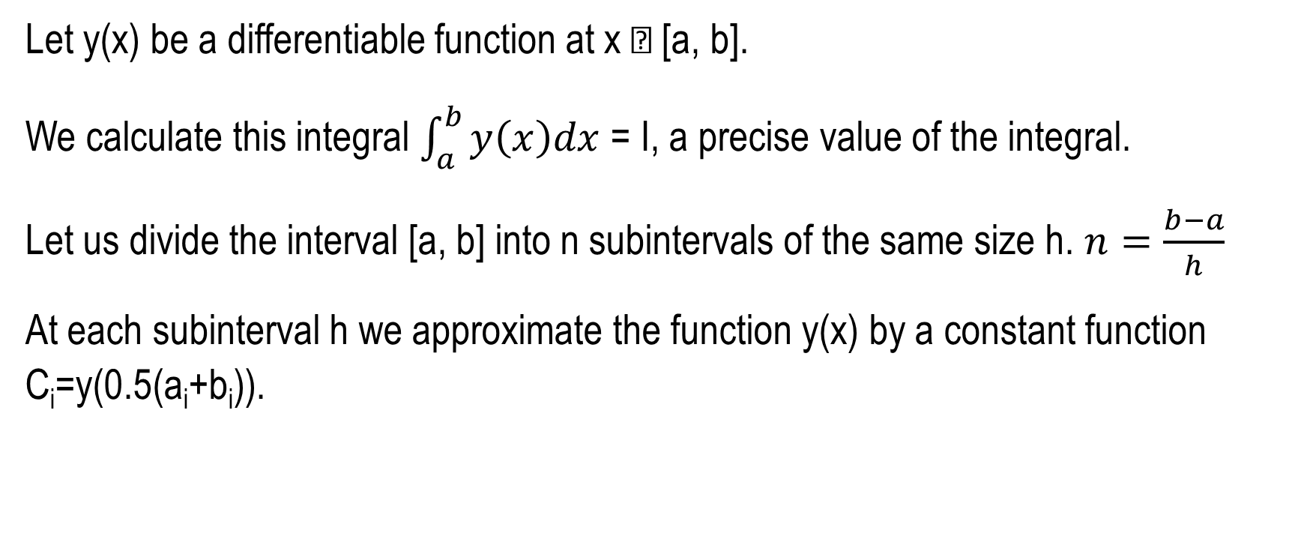
Let y(x) be a differentiable function at x  [a, b].
We calculate this integral $\int_{a}^{b}{y\left(x\right)dx}$ = I, a precise value of the integral.
Let us divide the interval [a, b] into n subintervals of the same size h. $n=\frac{b−a}{h}$
At each subinterval h we approximate the function y(x) by a constant function C_{i}=y(0.5(a_{i}+b_{i})).

Slide 63

$\sum_{i=1}^{n}{\int_{a_{i}}^{b_{i}}{C_{i}dx= I_{MR}}}$, which is the approximate value of the integral, computed using mid rectangles rule.
h=b_{i} - a_{i}

Slide 64
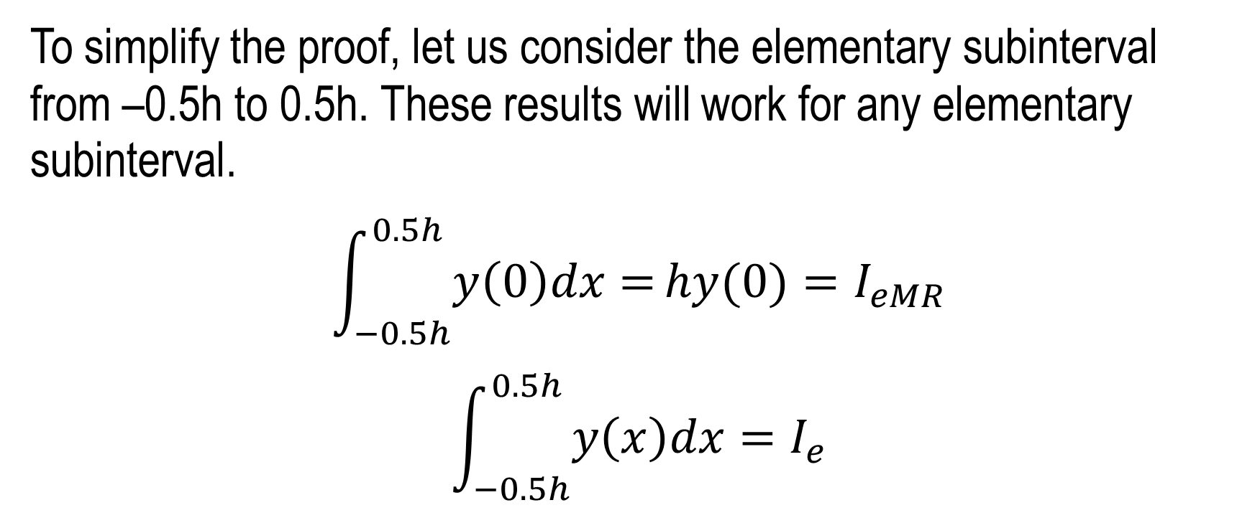
To simplify the proof, let us consider the elementary subinterval from –0.5h to 0.5h. These results will work for any elementary subinterval.
$$\int_{−0.5h}^{0.5h}{y\left(0\right)dx=}hy(0)=I_{eMR}$$
$$\int_{−0.5h}^{0.5h}{y\left(x\right)dx=I_{e}}$$

Slide 65
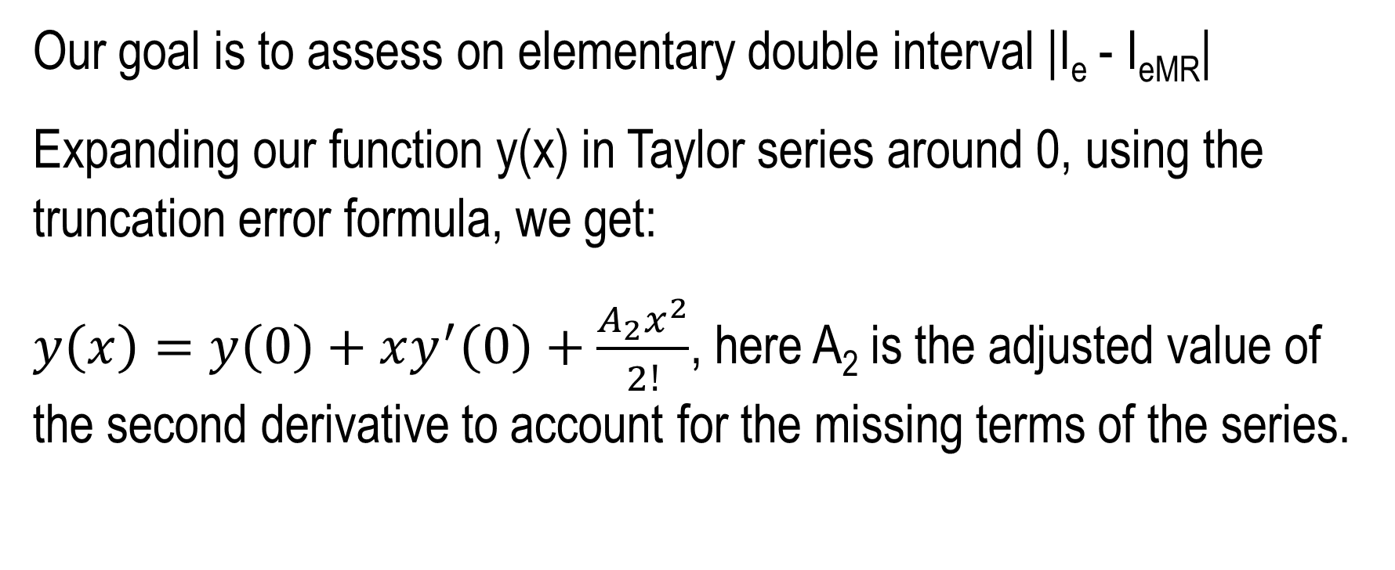
Our goal is to assess on elementary double interval |I_{e} - I_{eMR}|
Expanding our function y(x) in Taylor series around 0, using the truncation error formula, we get:
$y\left(x\right)=y\left(0\right)+xy^{′}\left(0\right)+\frac{A_{2}x^{2}}{2!}$, here A₂ is the adjusted value of the second derivative to account for the missing terms of the series.

Slide 66

$\int_{−0.5h}^{0.5h}{\left(y\left(0\right)+xy^{′}\left(0\right)+\frac{A_{2}x^{2}}{2!}\right)dx}=hy(0)+\frac{A_{2}h^{3}}{24}=I_{e}$

Slide 67

$$|I_{e}−I_{eMR}|=\frac{{|A}_{2}|h^{3}}{24}$$

Slide 68
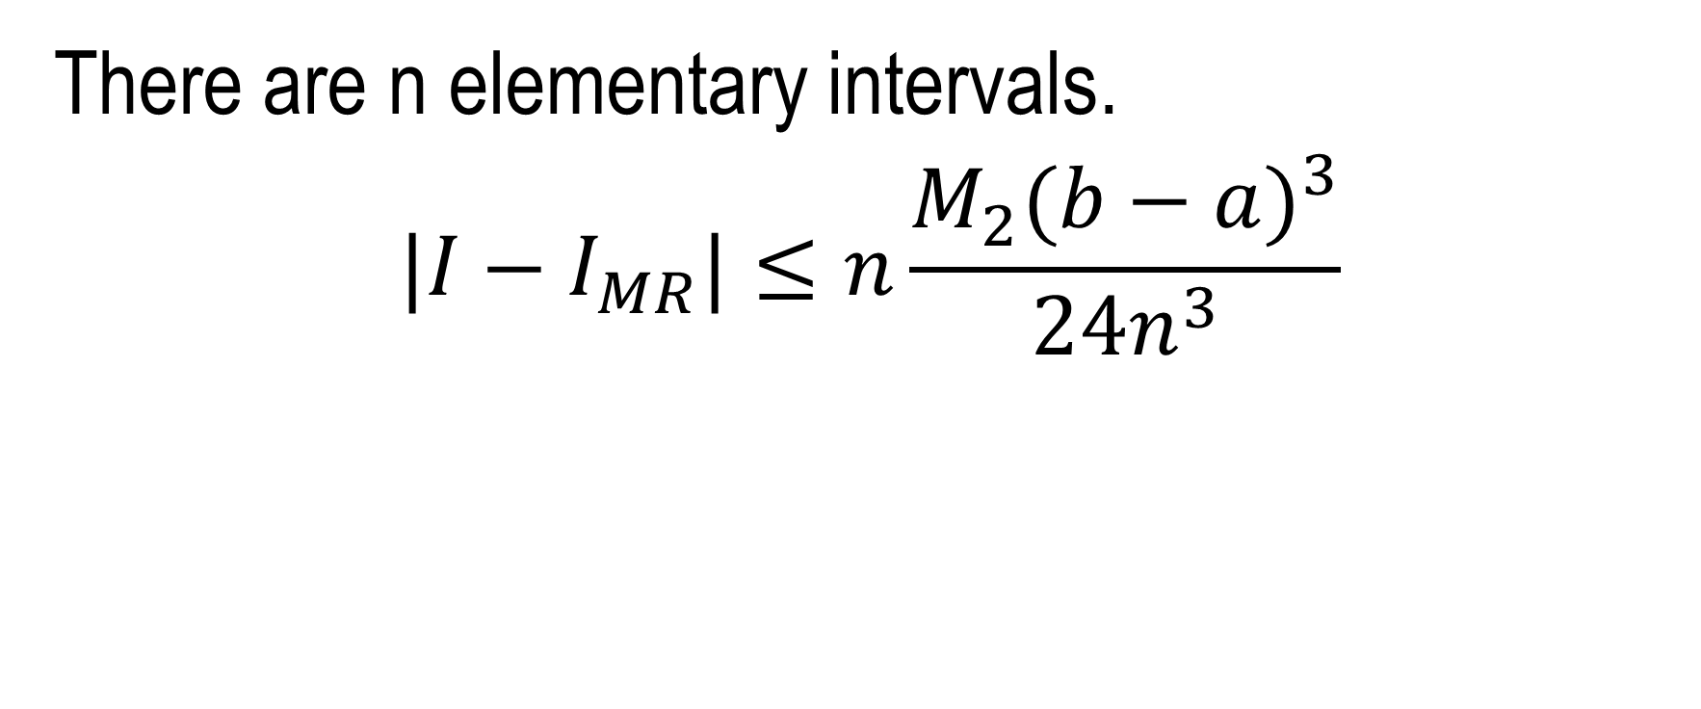
There are n elementary intervals.
$$|I−I_{MR}|≤n\frac{M_{2}{(b−a)}^{3}}{{24n}^{3}}$$

Slide 69
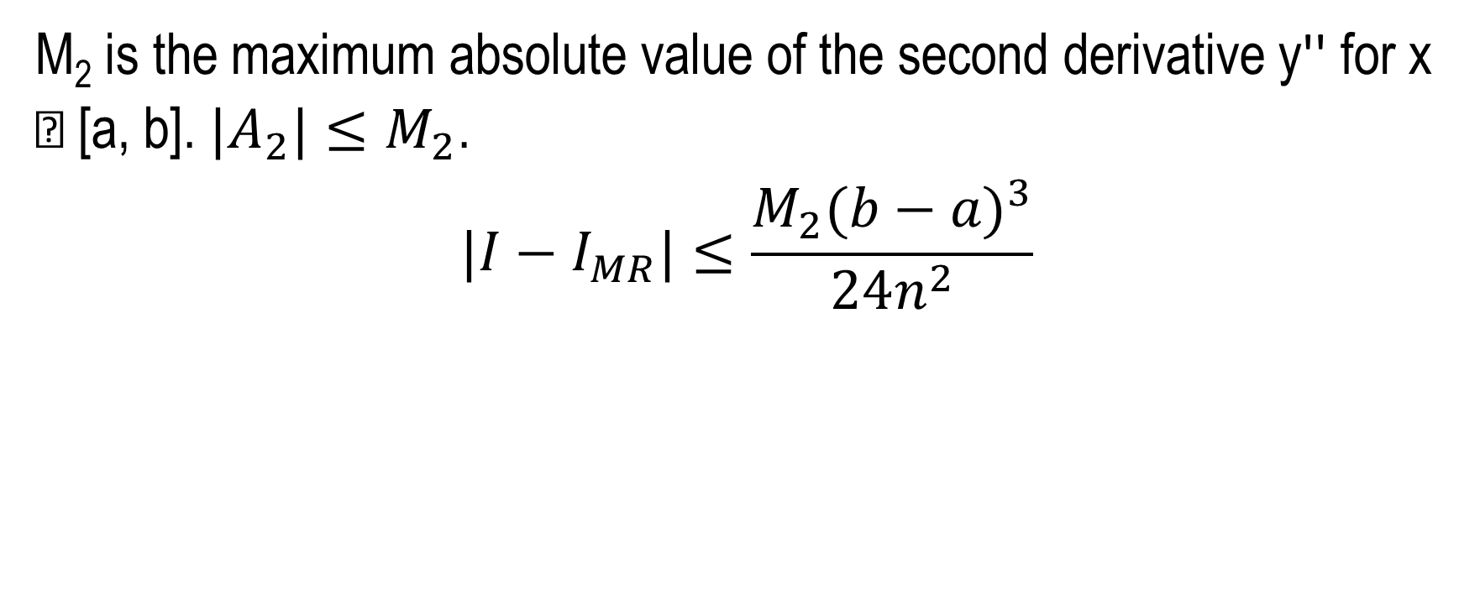
M₂ is the maximum absolute value of the second derivative y'' for x  [a, b]. ${|A}_{2}|≤M_{2}$.
$$|I−I_{MR}|≤\frac{M_{2}{(b−a)}^{3}}{24n^{2}}$$

Slide 70
https://calculus12s.weebly.com/uploads/2/5/3/9/25393482/midrectanglesruleintegrationerrorbounds.docx

Slide 71

m₄ = 2: Trapezoidal rule
We calculate the largest possible error of numerical calculating of the integral I = $\int_{a}^{b}{f\left(x\right)dx}$
using trapezoidal rule I_{T}.

Slide 72
We approximate our function f(x) with a straight line S(x) at each small subinterval.
We must find the inequality for D = |I - I_{T}|.

Slide 73
From 0 to h:
Straight line: S(x) = sx + i
Parabola: P(x) = ax² + bx + c
Both S(x) and P(x) pass through points (x₀, y₀) and (x₁, y₁). Here we take x₀ = 0 and x₁ = h.

Slide 74
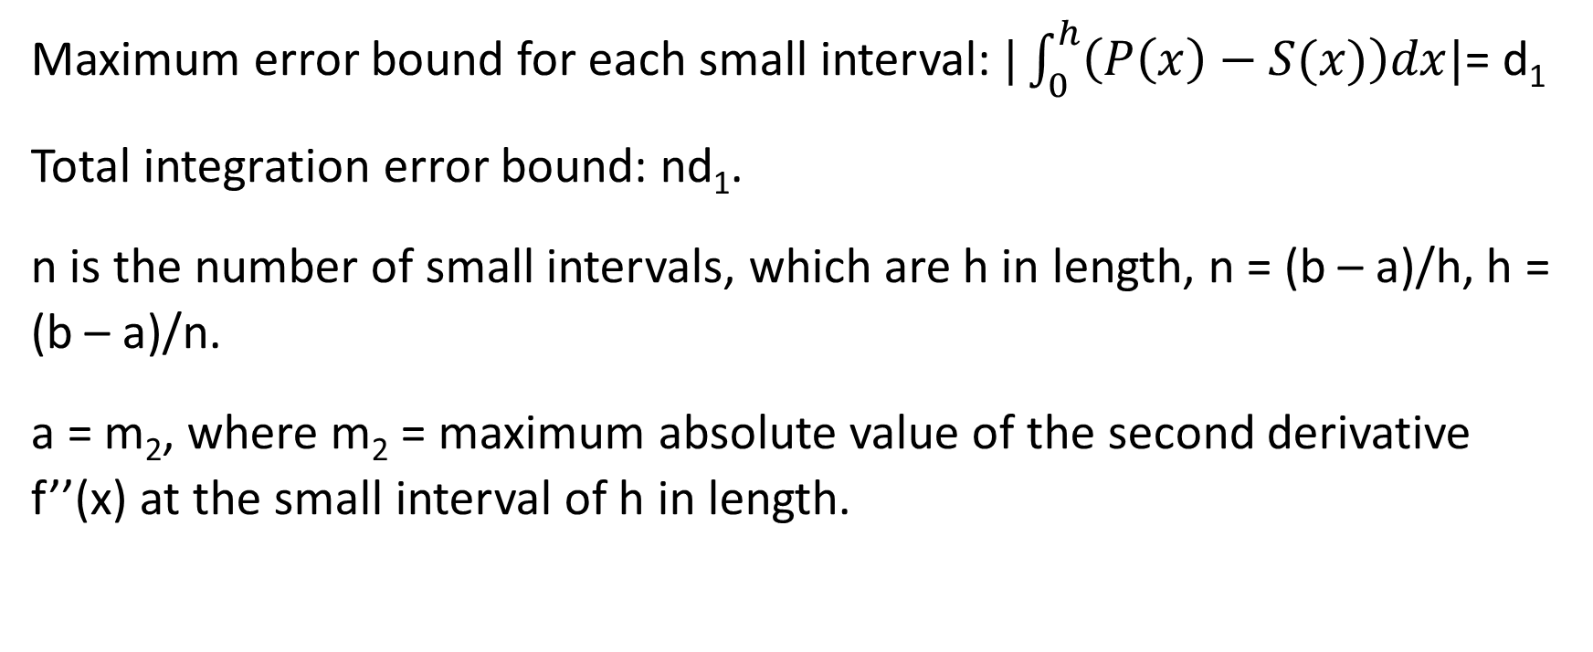
Maximum error bound for each small interval: $|\int_{0}^{h}{\left(P\left(x\right)−S(x)\right)dx|}$= d₁
Total integration error bound: nd₁.
n is the number of small intervals, which are h in length, n = (b – a)/h, h = (b – a)/n.
a = m₂, where m₂ = maximum absolute value of the second derivative f’’(x) at the small interval of h in length.

Slide 75
We must find b, c, s, i using the facts that S(x) and P(x) pass through the points (x₀, y₀) and (x₁, y₁).
s = (y₁ – y₀)/h, i = y₀, b = (y₁ – y₀)/h – ah, c = y₀.
d₁ = |m₂h³/6 + (y₁ – y₀)h/2 – m₂h³/4 + hy₀ –((y₁ – y₀)h/2 + hy₀)| ≤ m₂h³/12.

Slide 76
Thus, on the whole interval [a, b] D₁ ≤ M₂h³/12, where is M₂ maximum absolute f’’(x) at the whole [a, b] interval.
D = n D₁ = |I - I_{T}| ≤M₂(b - a)³/(12n²)

Slide 77
https://calculus12s.weebly.com/uploads/2/5/3/9/25393482/trapezoidalruleintegrationerrorbounds.docx

Slide 78
m₄ = 3: Simpson rule
Simpsons rule integration error bounds:
Proof:
Let y(x) be a differentiable function at x  [a, b].

Slide 79
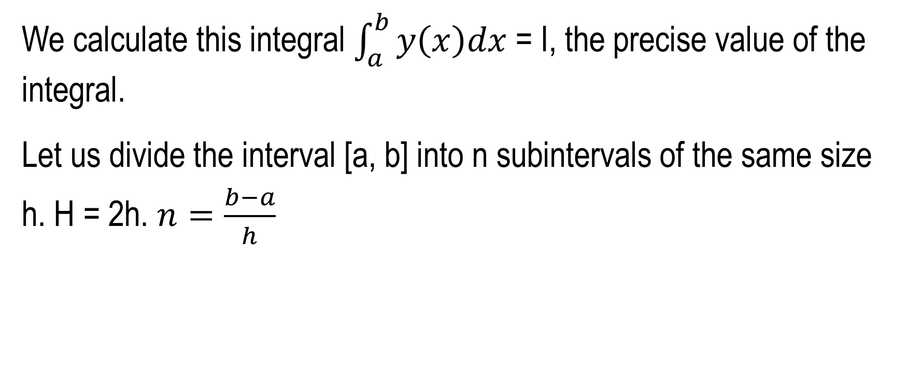
We calculate this integral $\int_{a}^{b}{y\left(x\right)dx}$ = I, the precise value of the integral.
Let us divide the interval [a, b] into n subintervals of the same size h. H = 2h. $n=\frac{b−a}{h}$

Slide 80
At each subinterval H we approximate the function y(x) by a quadratic function Q(x) = Ax² + Bx + C,
here A, B and C are unknown constants.

Slide 81
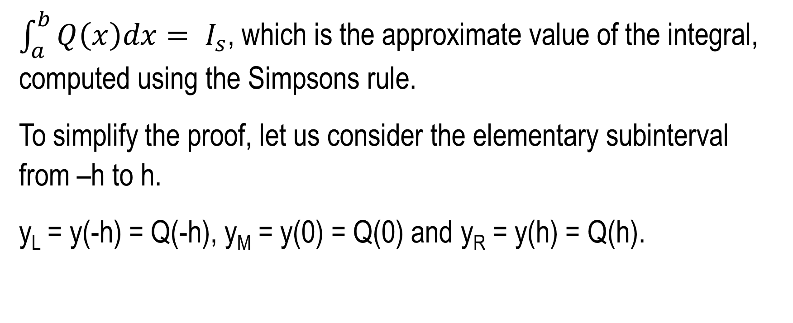
$\int_{a}^{b}{Q\left(x\right)dx= I_{s}}$, which is the approximate value of the integral, computed using the Simpsons rule.
To simplify the proof, let us consider the elementary subinterval from –h to h.
y_{L} = y(-h) = Q(-h), y_{M} = y(0) = Q(0) and y_{R} = y(h) = Q(h).

Slide 82
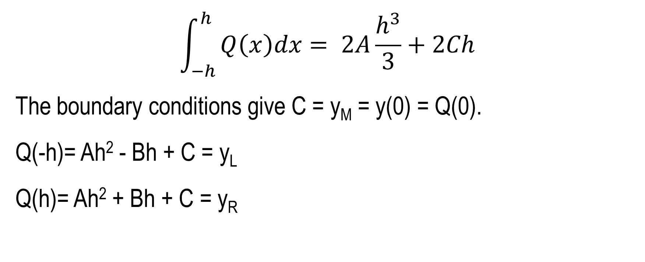
$$\int_{−h}^{h}{Q\left(x\right)dx= 2A\frac{h^{3}}{3}}+2Ch$$
The boundary conditions give C = y_{M} = y(0) = Q(0).
Q(-h)= Ah² - Bh + C = y_{L}
Q(h)= Ah² + Bh + C = y_{R}

Slide 83
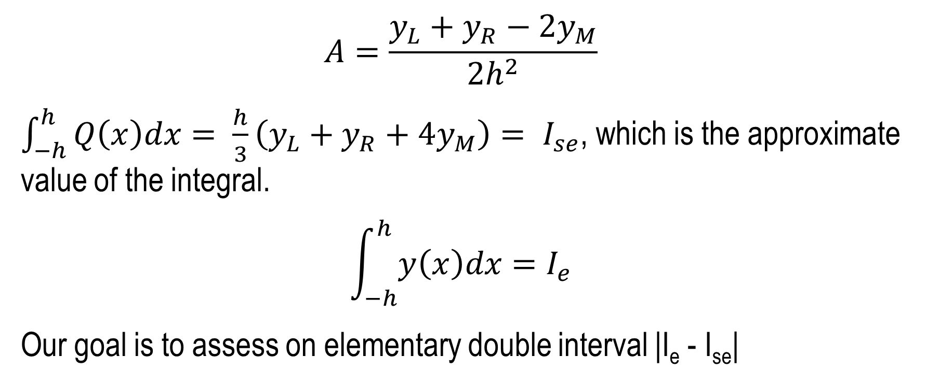
$$A=\frac{y_{L}+y_{R}−2y_{M}}{2h^{2}}$$
$\int_{−h}^{h}{Q\left(x\right)dx= \frac{h}{3}}\left(y_{L}+y_{R}+4y_{M}\right)= I_{se}$, which is the approximate value of the integral.
$$\int_{−h}^{h}{y\left(x\right)dx=I_{e}}$$
Our goal is to assess on elementary double interval |I_{e} - I_{se}|

Slide 84
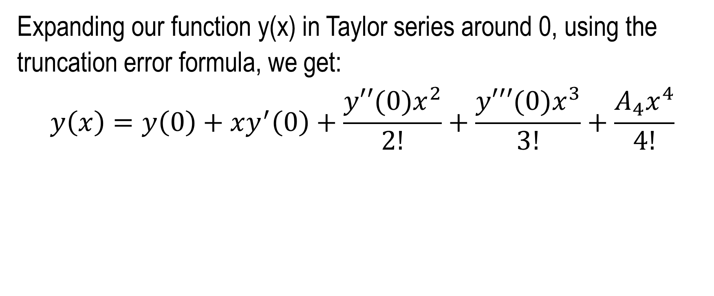
Expanding our function y(x) in Taylor series around 0, using the truncation error formula, we get:
$$y\left(x\right)=y\left(0\right)+xy^{′}\left(0\right)+\frac{y′′(0)x^{2}}{2!}+\frac{y′′′(0)x^{3}}{3!}+\frac{A_{4}x^{4}}{4!}$$

Slide 85

$$\int_{−h}^{h}{\left(y\left(0\right)+xy^{′}\left(0\right)+\frac{y′′(0)x^{2}}{2!}+\frac{y′′′(0)x^{3}}{3!}+\frac{A_{4}x^{4}}{4!}\right)dx}=2hy(0)+\frac{y′′(0)h^{3}}{3}+\frac{A_{4}h^{5}}{60}=I_{e}$$

Slide 86
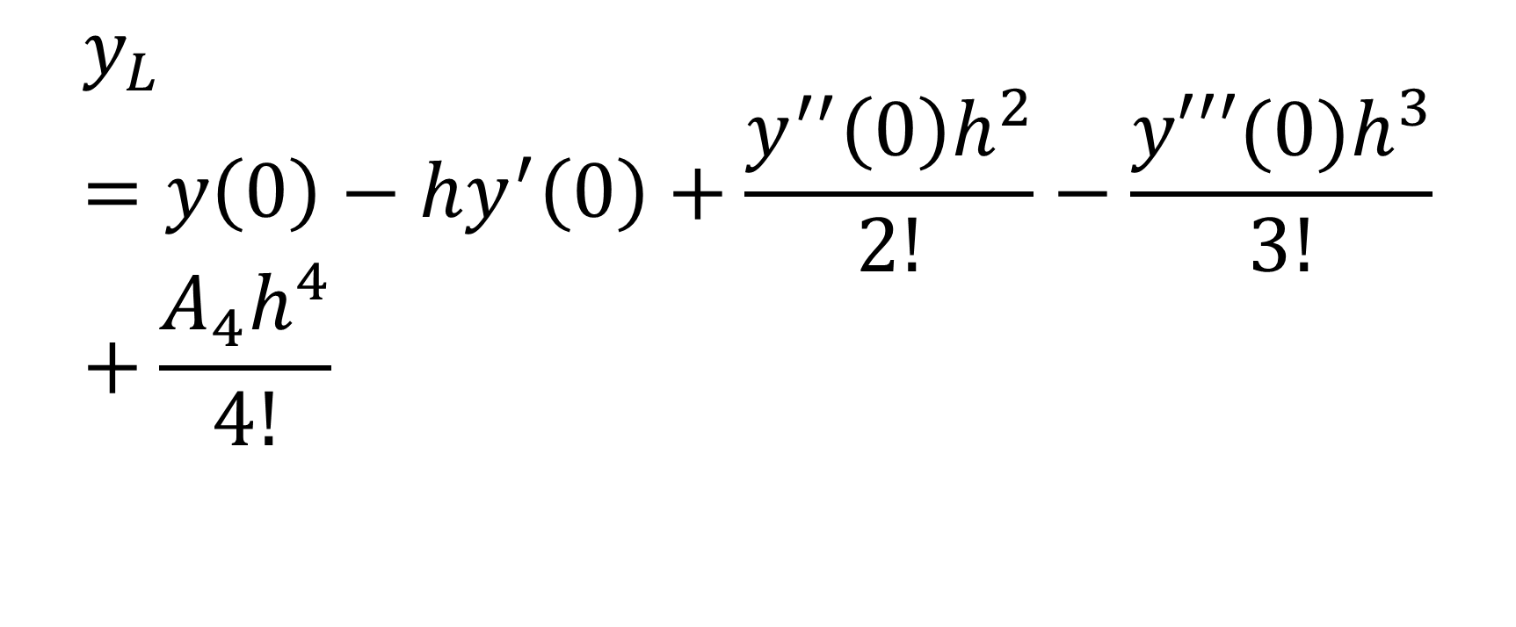
$$y_{L}=y\left(0\right)−hy^{′}\left(0\right)+\frac{y^{′′}\left(0\right)h^{2}}{2!}−\frac{y′′′(0)h^{3}}{3!}+\frac{A_{4}h^{4}}{4!}$$

Slide 87

$$y_{R}=y\left(0\right)+hy^{′}\left(0\right)+\frac{y^{′′}\left(0\right)h^{2}}{2!}+\frac{y′′′(0)h^{3}}{3!}+\frac{A_{4}h^{4}}{4!}$$

Slide 88

$$y_{L}+y_{R}=2y\left(0\right)+y^{′′}\left(0\right)h^{2}+\frac{A_{4}h^{4}}{12}$$

Slide 89

$$I_{se}=\frac{h}{3}\left(y_{L}+y_{R}+{4y}_{M}\right)=2hy_{M}+\frac{y′′(0)h^{3}}{3}+\frac{A_{4}h^{5}}{36}$$

Slide 90

Here A₄ is the adjusted value of the forth derivative to account for the missing terms of the series.
$$|I_{e}−I_{se}|=\frac{{|A}_{4}{|h}^{5}}{90}$$

Slide 91

There are 0.5n of elementary double intervals.
$$|I−I_{s}|≤\frac{n}{2}\frac{M_{4}{(b−a)}^{5}}{{90n}^{5}}$$

Slide 92

M₄ is the maximum absolute value of the forth derivative y⁽⁴⁾ for x  [a, b]. ${|A}_{4}|≤M_{4}$.
$$|I−I_{s}|≤\frac{M_{4}{(b−a)}^{5}}{180n^{4}}$$

Slide 93
https://calculus12s.weebly.com/uploads/2/5/3/9/25393482/simpsonsruleintegrationerrorbounds.docx

Slide 94

Unsolvable on paper integrals
Calculate this integral: $\int_{1/T}^{1}{\frac{sin⁡(x)}{x}dx}$
sin(x)/x from 1/12 to 1
https://www.integral-calculator.com/

Slide 95

Improper integrals
Calculate $\int_{1}^{∞}{x^{−T}}dx$

Slide 96

Find $\int_{0}^{1}{x^{\frac{−1}{T}}dx}$

Slide 97

Calculate a. $\int_{0}^{1}{\frac{dx}{\sqrt{1−x^{2}}}}$ b. $\int_{0}^{1}{\frac{sinx}{x}dx}$ Use 2T nodes.

Slide 98
https://calculus12s.weebly.com/uploads/2/5/3/9/25393482/simpson-rule-numerical-integration-method.txt

Slide 99
Error analysis for integral
Perform the errors analysis for the integral error bounds for x⁶ @[0, 1] taking 2T intervals.

Slide 100
Multiple integrals
Find multiple integral of F = xy = z, 0 < x < T, 0 < y < k.

Slide 101
Application of integral
Calculate area bellow the curve f(x)=1+cos(Tx)@[1/s,1/k].

Slide 102
Calculate area between the curves
f(x)=1+cos(Tx) and g(x)= 1+sin(Tx)@[1/s,1/k].

Slide 103

Calculate average value, center of mass and moment of inertia of f(x)=1+cos(Tx)@[1/s,1/k].
$$\frac{\int_{a}^{b}{f\left(x\right)dx}}{b−a}$$

Slide 104

$$\frac{\int_{a}^{b}{f\left(x\right)xdx}}{\int_{a}^{b}{f\left(x\right)dx}}$$

Slide 105

$$\int_{a}^{b}{f\left(x\right)x^{2}dx}$$

Slide 106

Find arc length of f(x)
a. -0.006x²+0.3x@[1/s,11-1/k],
b. 1+cos(Tx)@[1/s,1/k],
c. x²@[0,T].
$$\int_{a}^{b}{\sqrt{1+{\left(f′(x)\right)}^{2}}}dx$$

Slide 107

Calculate revolutionary volume and surface area of
f(x) = 1 + cos(Tx) @ [1/s, 1/k].
$$π\int_{a}^{b}{{(f(x))}^{2}dx}$$
$$2π\int_{a}^{b}{f(x)\sqrt{1+{\left(f′(x)\right)}^{2}}}dx$$

Slide 108
Differential equations
Solve these differential equations:
Ordinary differential equations:
y' = y using Euler method for m₂ + 2 unitary steps.
y(0) = 1.
https://en.wikipedia.org/wiki/Euler_method

Slide 109
Question:
y' = Ty

Slide 110
Partial differential equations
Determine the type of the partial differential equation.
m₂ = 0: -6Hxx + 7Hxt – 5Htt +675Hx – 34Ht + 54356 = 0
m₂ = 1: 39Hxx + 23Hxt – 305Htt - 6567Hx +56465Ht - 67467 = 0

Slide 111
Series
Find T! and T-th Fibonacci number.
http://mathworld.wolfram.com/GammaFunction.html
https://en.wikipedia.org/wiki/Fibonacci_number

Slide 112

Calculate
a.$\sum_{c=1}^{T}{\frac{{(−1)}^{c}}{c}}$ b.$\sum_{c=1}^{T}{\frac{1}{c}}$ c.$\sum_{c=1}^{T}{c^{−4}}$d.$\sum_{c=1}^{T}{c^{−6}}$e.$\sum_{c=0}^{T}{b^{c}}$f.$\sum_{c=1}^{T}{c^{−2}}$g.$\sum_{c=1}^{T}{c^{−3}}$h.$\sum_{c=0}^{T}{\frac{{(−1)}^{c}}{2c+1}}$ i.$\sum_{c=1}^{T}{c^{−5}}$

Slide 113

Find $\sum_{c=0}^{∞}{T^{−c}}$

Slide 114
Calculate π for T terms.
https://calculus12s.weebly.com/uploads/2/5/3/9/25393482/inverse2powers.txt

Slide 115
Expand (a + b)^{L}. L = m₁₀.
1
1 1
1 2 1
1 3 3 1
1 4 6 4 1
1 5 10 10 5 1
1 6 15 20 15 6 1
1 7 21 35 35 21 7 1
1 8 28 56 70 56 28 8 1
1 9 36 84 126 126 84 36 9 1

Slide 116

Functional series
Find the convergence radius and the sum.
$$\sum_{c=0}^{∞}{{\left(Tx\right)}^{c}}$$

Slide 117

Calculate $\sum_{c=0}^{∞}{C(p,c)}{\left(Tx\right)}^{c}$

Slide 118
Taylor series
Expand sin(Tx) in the Taylor Series around 0.
Take only terms 0, 1, 2, 3, 4.

Slide 119

Calculate $\sqrt[3]{27+1/T}$ using linear approximation.

Slide 120
Give truncation error for T terms of Taylor series for f(x).

Slide 121
Fourier Series
Expand Tx in the Fourier Series.
Take only terms 0, 1, 2, 3, 4.
12*x*sin(x)/pi from –π to π
12*x*sin(2x)/pi from –π to π
12*x*sin(3x)/pi from –π to π
12*x*sin(4x)/pi from –π to π
https://www.integral-calculator.com/

Slide 122
Statistical calculus
Calculate correlation between s and date of birth.

Slide 123
What is probability of randomly writing T letters?

Slide 124

Analyze normal distribution curve. Find its inflection point.
https://www.symbolab.com/solver/function-inflection-points-calculator
$$N\left(x\right)=\frac{1}{\sqrt{π}}\int_{−∞}^{x}{e^{{−x}^{2}}dx}$$
Calculate N(s).
e^(-x^2)/sqrt(pi)
from – infinity to 19107012
https://www.integral-calculator.com/

Slide 125

What is Cauchy distribution?
https://en.wikipedia.org/wiki/Cauchy_distribution
Why is (π(1 + x²))⁻¹ important? Find its inflection point.
https://www.symbolab.com/solver/function-inflection-points-calculator
$$C\left(x\right)=\frac{1}{π}\int_{−∞}^{x}{{\left(1+x^{2}\right)}^{−1}dx}$$
Calculate C(s).
((1+x^2)pi)^(-1)
from – infinity to 19107012
https://www.integral-calculator.com/

Slide 126
If you toss T fair coins, then what is the most likely number of heads? Why?

