Slide 1
CALCULUS III
CHAPTER 4: Vector integrals and integral theorems
Vector integrals
Line integrals
Surface integrals
Volume integrals
Integral theorems
The divergence theorem
Green’s theorem in the plane
Stoke’s theorem
Conservative fields and scalar potentials
Vector potentials

Slide 2
VECTOR INTEGRALS

Slide 3
Line integral
Also called path integral (physics), contour integral, curve integral is an integral where the function is integrated along a curve r(t) instead of along a straight line (Riemann)
The function to be integrated can be either a scalar of a vector field
If we want to integrate a scalar field f along a curve r(t), the line integral is simply
The line integral of a scalar field f over a curve C can be thought of as the area under the curve C along a surface z = f(x,y), described by the field.

Slide 4
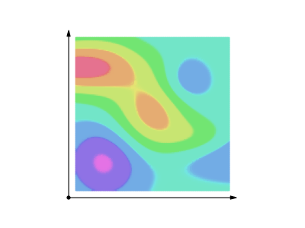
Line integral of a scalar field over a curve

Slide 5
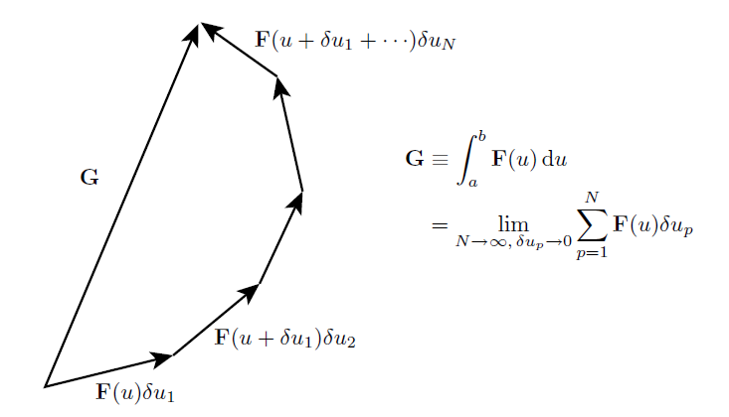
Line integral of vector fields: Simple integration of a vector
Geometrically

Slide 6
Line integral of a vector field
Line integral of a vector field

Slide 7
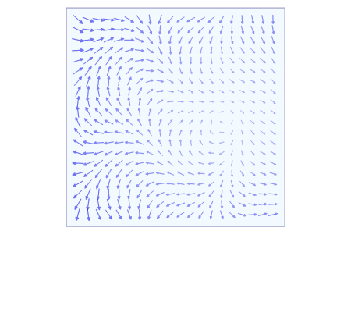
Line integral of a vector field

Slide 8
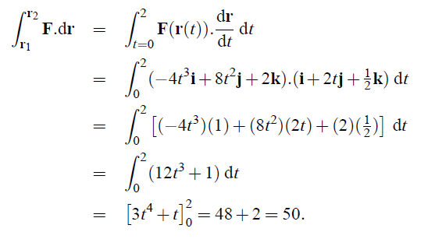

Slide 10
Interpretation of line integrals of vector fields: work / flow
In general the work is said to be ‘path dependent’ because the result of the integral depends on the concrete shape of r.
Do not confuse with path integration formulation of quantum mechanics (Feynman) (these are integration over a space of paths)

Slide 11
Surface integrals
The surface integral is a definite integral taken over a surface.
It can be thought of as the double integral analog of the line integral.
Given a surface, one may integrate over its scalar fields, and vector fields
are surface integrals of scalar
fields over plane surfaces
Therefore, we need to generalize this concept:
For curved surfaces
For vector fields

Slide 12
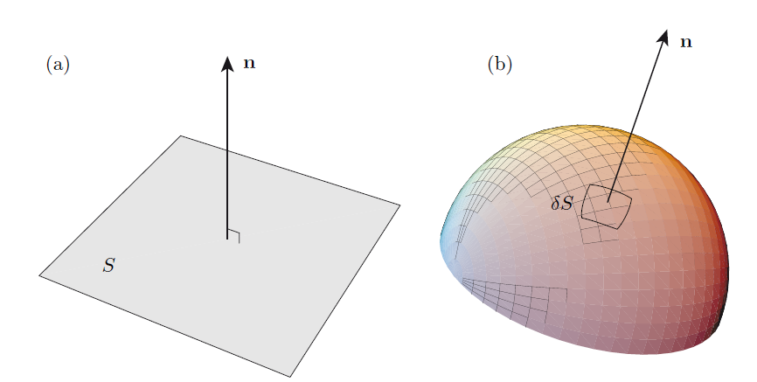
Curved surfaces: area elements

Slide 13
Surface integrals of vector fields
( These can be thought as integration of scalar field $f$ over a surface: $\int{f|dS|}$ )

Slide 14
(integration of a vector field over a plane surface)

Slide 15
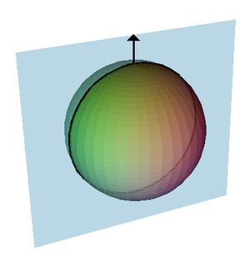
(integration of a vector field over a curved surface – a sphere)

Slide 16
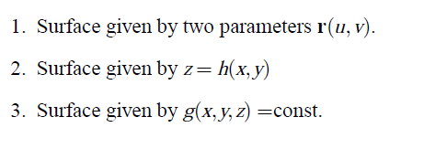
Surface integrals of vector fields: a general approach
Recall that in general, a surface can be described in three ways
The optimal description will depend on the concrete surface to be described
We will therefore develop three different ways of calculating the surface integral, depending on the specific description of the surface
(parametric form)
(explicit form)
(implicit form)

Slide 17
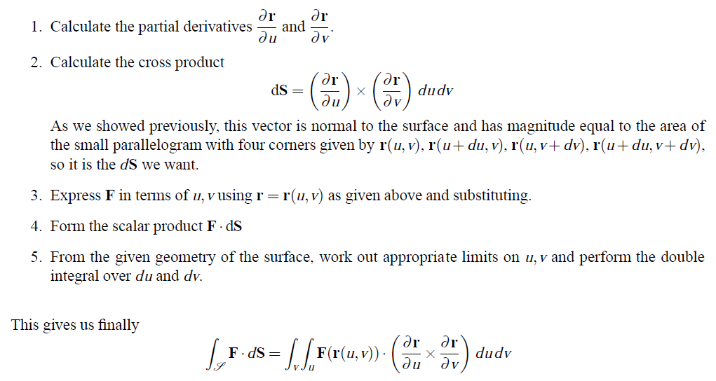
Surface integrals of vector fields Surface described in parametric form (2 parameters)

Slide 18
Surface integrals of vector fields Surface described in explicit form

Slide 19
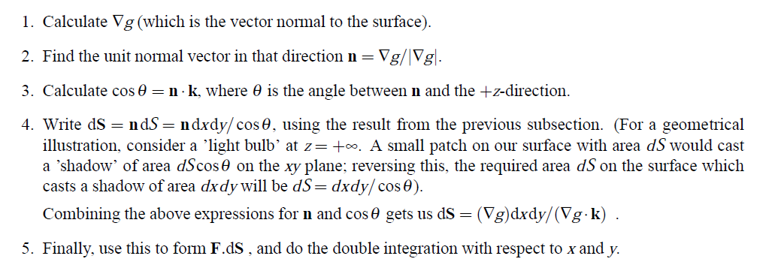
Surface integrals of vector fields Surface described in implicit form

Slide 20
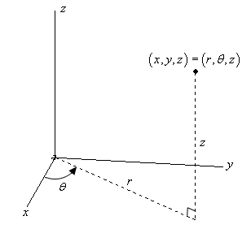
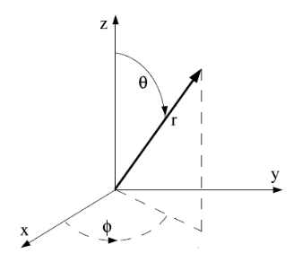
Volume integrals
In this section we will only consider integrals of scalar or vector fields over volumes defined in $ℝ^{3}$ , either in cartesian or in generic curvilinear coordinates.
Where we recall that the volument element for canonical curvilinear coordinates
CYLINDRICAL $dV=rdrdθdz$
SPHERICAL $dV= r^{2}sinθ drdθdφ$

Slide 21
INTEGRAL THEOREMS

Slide 22
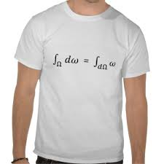
In the preceding sections we have studied how to calculate the integrals of vector fields over curves (line integrals), surfaces, and volumes.
It turns out that there exist relations between these kind of integrals in some circumstances.
These relations are generically gathered under the label integral theorems.
These theorems link the concepts of line and surface integrals through the differential operator

Slide 23
The divergence theorem
Statement
This theorem relates the surface integral of a vector field with the volume integral of a scalar field constructed as the divergence of the vector field:
The surface S over which the integration is performed is indeed the boundary of the volume V
Intuitively, it states that the sum of all sources minus the sum of all sinks gives the net flow out of a region.

Slide 24
The divergence theorem
Statement
This theorem also requires some mathematical conditions: - the volume V must be compact and its boundary surface must be piecewise smooth - the vector field F must be continuously differentiable on the neighborhood of V
This theorem is also called Gauss theorem or Ostrogradsky's theorem, and is a special case of the more general Stoke’s theorem that we will see in the next section
This theorem is very important in physics (electromagnetism, fluid dynamics)

Slide 26
The divergence theorem
Statement
Corollary (vector form of divergence theorem)

Slide 27
The divergence theorem
Statement
This theorem is stated in $ℝ^{3}$. It has other versions in lower dimensions:
$ℝ$ : the 1-dimensional version reduces to the fundamental theorem of calculus, that links the concepts of derivative and integral of a scalar field
$ℝ^{2}$: the 2-dimensional version is called the Green’s theorem, that links the line integral of a vector field over a curve with the surface integral over a plane region. Let’s see this theorem in more detail.

Slide 28
Green’s theorem
Green's theorem is also special case of the Stokes theorem that we will explain in the next section, when applied to a region in the xy-plane

Slide 30
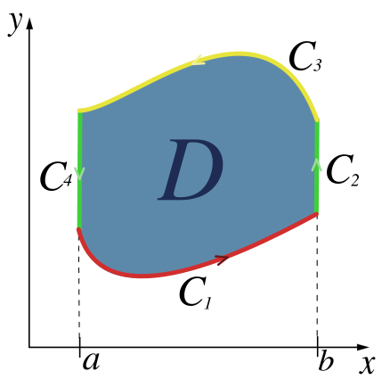
Green’s theorem
Corollary
D

Slide 31
Stoke’s theorem
This theorem relates the line integral of a vector field with the surface integral of another vector field, constructed as the curl of the former:

Slide 33
Stoke’s theorem
Corollary (vector form of Stokes theorem)

Slide 34
Some important applications of divergence, Green and Stoke’s theorems
Electromagnetism: Maxwell laws

Slide 35
Summarizing all of the above in a general theorem (not examinable)
The integral of a differential form ω over the boundary of some orientable manifold Ω is equal to the integral of its exterior derivative dω over the whole of Ω, i.e.
Fundamental theorem of calculus: f(x) dx is the exterior derivative of the 0-form, i.e. function, F: in other words, that dF = f dx (A closed interval [a, b] is a simple example of a one-dimensional manifold with boundary)
Divergence theorem
Green’s theorem
Stokes theorem is a special case of the general Stokes theorem (with n = 2) once we identify a vector field with a 1 form using the metric on Euclidean three-space.

Slide 36
Conservative fields and scalar potentials
Now that we have studied the generalities of integral theorems, we will analyse some concrete situations of special interest.
If F is conservative,

Slide 37
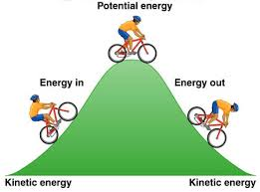
Conservative fields and scalar potentials
Physical interpretation of conservative fields
If F is interpreted as a force applied to a particle, then if F is conservative this means that the work needed to take a particle from position P to position Q is independent of the path
In other words, the net work in going round a path to where one started (P=Q) is zero: energy is conserved.
The gravitational field F(r) is an example of a conservative force. Its associated scalar potential φ(r) is a scalar field called the potential energy.
Usually, and without loss of generality, a minus sign is introduced:
to emphasize that if a particle is moved in the direction of the gravitational field, the particle decreases its potential energy, and viceversa.
Energy conservation: * The energy we need to use to take a biker from B to A is stored as potential energy, and released in terms of kinetic energy as we drop it from A to B. * This energy is independent of the slope of the hill (path independence).
A
B
B

Slide 39
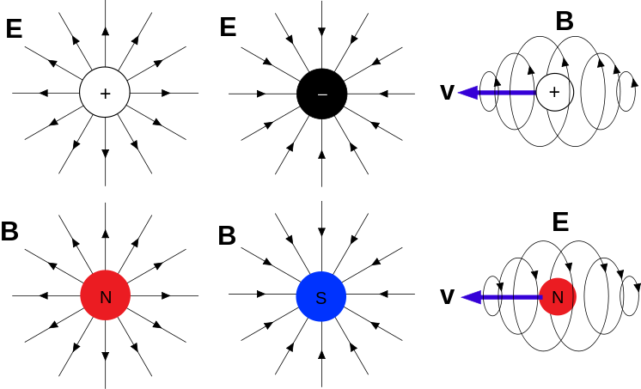
Divergence-free fields and potential vectors
A vector field F is divergence-free iff
As the divergence describes the presences of sources and sinks of the field, a divergence-free field means that the balance of sources and sinks is null.
Example: the magnetic field B is empirically divergence-free, and one of the Maxwell equations is
This suggests that magnetic monopoles (isolated magnetic ‘charges’, i.e. isolated sources or sinks of magnetic fields) do not exist (however string theories do predict their existence, so it’s currently a hot topic in particle physics).
Electric monopoles (charges)
Magnetic monopoles

Slide 40
Divergence-free fields and potential vectors
Gauge transformation
Most fundamental physical theories are gauge invariant.

