Slide 1
12 Lecture in calculus
Homework
Even, odd functions
Parallel lines
Spherical coordinates

Slide 2
Homework is due 10 December 2014. It is on the web site.

Slide 3
Chess are not related to calculus, chess are related to discrete math

Slide 4
Presentations analysis

Slide 5
Differential equations (continued)

Slide 6
Exponential growth and decay

Slide 7
Invariance of partial derivatives to the order of differentiation

Slide 8
Even, odd functions (reflection, rotation)

Slide 9
Linear functions

Slide 10
Parallel lines, perpendicular lines going through the points particular lines

Slide 11
Quadratic functions

Slide 12
Trigonometric functions

Slide 13
Transcendental functions

Slide 14
Integration

Slide 15
Lower sums for integrals

Slide 16
Mid-point sums for integrals

Slide 17
Upper sums for integrals

Slide 18
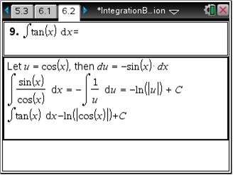
Integration by substitution

Slide 19
Jacobian

Slide 20
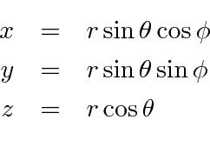
Spherical coordinates

