Slide 1
Calculus 1.1
Definitions
History
Number theory
Functions
Continuity
Limit
Derivative
Bibliography

Slide 2
No mistakes, right decisions
It is all about making no mistakes and right decisions

Slide 3
Patterns and invariants
It is all about patterns and invariants

Slide 4
What is calculus?
Why do we need to study calculus?

Slide 5
Calculus is the mathematical study of change. It has two major branches, differential calculus (concerning rates of change and slopes of curves), and integral calculus (concerning accumulation of quantities and the areas under and between curves); these two branches are related to each other by the fundamental theorem of calculus. Generally considered to have been founded in the 17th century by Newton and Leibniz.
It is all about continuity, infinitely small values, linear differentiation and integration.
Finding derivative or integral is the essence of calculus (problems 1 and 2).

Slide 6
Mathematics
Mathematics is the study of topics such as quantity (numbers), structure, space, and change. There is a range of views among mathematicians and philosophers as to the exact scope and definition of mathematics. Mathematicians seek out patterns and use them to formulate new conjectures. Mathematicians resolve the truth or falsity of conjectures by mathematical proof. When mathematical structures are good models of real phenomena, then mathematical reasoning can provide insight or predictions about nature. Through the use of abstraction and logic, mathematics developed from counting, calculation, measurement, and the systematic study of the shapes and motions of physical objects. Practical mathematics has been a human activity for as far back as written records exist. The research required to solve mathematical problems can take years or even centuries of sustained inquiry.

Slide 7
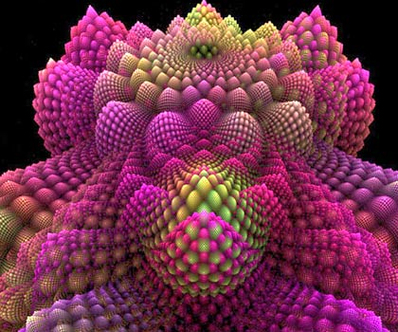
Fractal

Slide 8
Telematics

Slide 9
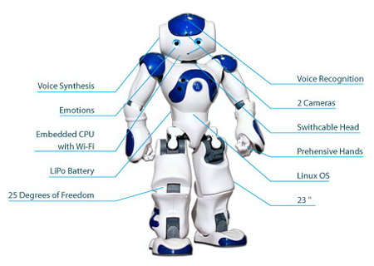
Robotics

Slide 10
Soccer

Slide 11
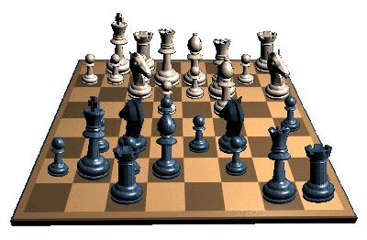
Chess

Slide 12
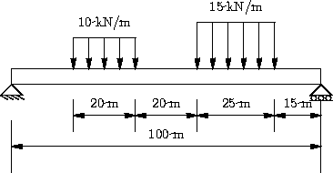
Solid mechanics

Slide 13
Fluid dynamics

Slide 14
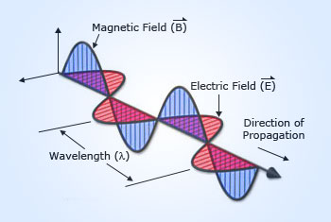
Electromagnetism

Slide 15
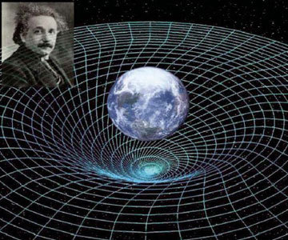
Relativity theory

Slide 16
Axiom
An axiom or postulate is a premise or starting point of reasoning. As classically conceived, an axiom is a premise so evident as to be accepted as true without controversy. The word comes from the Greek 'that which is thought worthy or fit' or 'that which commends itself as evident.' As used in modern logic, an axiom is simply a premise or starting point for reasoning. Axioms define and delimit the realm of analysis; the relative truth of an axiom is taken for granted within the particular domain of analysis, and serves as a starting point for deducing and inferring other relative truths. No explicit view regarding the absolute truth of axioms is ever taken in the context of modern mathematics, as such a thing is considered to be an irrelevant and impossible contradiction in terms.

Slide 17
Continuity Axioms
"The" continuity axiom is an additional Axiom which must be added to those of Euclid's Elements in order to guarantee that two equal circles of radius intersect each other if the separation of their centers is less than (Dunham 1990). The continuity axioms are the three of Hilbert's axioms which concern geometric equivalence.

Slide 18
Theorem
A theorem is a statement that has been proven on the basis of previously established statements, such as other theorems—and generally accepted statements, such as axioms. The proof of a mathematical theorem is a logical argument for the theorem statement given in accord with the rules of a deductive system. The proof of a theorem is often interpreted as justification of the truth of the theorem statement. In light of the requirement that theorems be proved, the concept of a theorem is fundamentally deductive, in contrast to the notion of a scientific theory, which is empirical.

Slide 19
inverse function theorem
The inverse function theorem gives sufficient conditions for a function to be invertible in a neighborhood of a point in its domain. The theorem also gives a formula for the derivative of the inverse function.

Slide 20
Extreme value theorem
The extreme value theorem states that if a real-valued function f is continuous in the closed and bounded interval [a,b], then f must attain a maximum and a minimum, each at least once.

Slide 21
Fermat's theorem
Fermat's theorem (not to be confused with Fermat's last theorem) is a method to find local maxima and minima of differentiable functions on open sets by showing that every local extremum of the function is a stationary point (the function derivative is zero in that point).

Slide 22
Fubini's theorem
Fubini's theorem, introduced by Guido Fubini (1907), is a result which gives conditions under which it is possible to compute a double integral using iterated integrals.

Slide 23
Fundamental theorem of calculus
The fundamental theorem of calculus is a theorem that links the concept of the derivative of a function with the concept of the integral.
The first part of the theorem, sometimes called the first fundamental theorem of calculus, is that an indefinite integral of a function can be reversed by differentiation. This part of the theorem is also important because it guarantees the existence of antiderivatives for continuous functions.
The second part, sometimes called the second fundamental theorem of calculus, is that the definite integral of a function can be computed by using any one of its infinitely many antiderivatives. This part of the theorem has key practical applications because it markedly simplifies the computation of definite integrals.

Slide 24
Intermediate value theorem
the intermediate value theorem states that if a continuous function f with an interval [a, b] as its domain takes values f(a) and f(b) at each end of the interval, then it also takes any value between f(a) and f(b) at some point within the interval. This has two important specializations: If a continuous function has values of opposite sign inside an interval, then it has a root in that interval (Bolzano's theorem). And, the image of a continuous function over an interval is itself an interval.

Slide 25
L'Hôpital's rule theorem
L'Hôpital's rule (pronounced: [lopiˈtal]) uses derivatives to help evaluate limits involving indeterminate forms. Application (or repeated application) of the rule often converts an indeterminate form to a determinate form, allowing easy evaluation of the limit. The rule is named after the 17th-century French mathematician Guillaume de L'Hôpital (also written L'Hospital), who published the rule in his 1696 book Analyse des Infiniment Petits pour l'Intelligence des Lignes Courbes (literal translation: Analysis of the Infinitely Small for the Understanding of Curved Lines), the first textbook on differential calculus. However, it is believed that the rule was discovered by the Swiss mathematician Johann Bernoulli.

Slide 26
Mean value theorem
The mean value theorem states, roughly: that given a planar arc between two endpoints, there is at least one point at which the tangent to the arc is parallel to the secant through its endpoints.
The theorem is used to prove global statements about a function on an interval starting from local hypotheses about derivatives at points of the interval.

Slide 27
Taylor's theorem
Taylor's theorem gives an approximation of a k times differentiable function around a given point by a k-th order Taylor polynomial. For analytic functions the Taylor polynomials at a given point are finite order truncations of its Taylor series, which completely determines the function in some neighborhood of the point. The exact content of "Taylor's theorem" is not universally agreed upon. Indeed, there are several versions of it applicable in different situations, and some of them contain explicit estimates on the approximation error of the function by its Taylor polynomial.

Slide 28
Gödel's completeness theorem
Gödel's completeness theorem is a fundamental theorem in mathematical logic that establishes a correspondence between semantic truth and syntactic provability in first-order logic. It makes a close link between model theory that deals with what is true in different models, and proof theory that studies what can be formally proven in particular formal systems.
It was first proved by Kurt Gödel in 1929. It was then simplified in 1947, when Leon Henkin observed in his Ph.D. thesis that the hard part of the proof can be presented as the Model Existence Theorem (published in 1949). Henkin's proof was simplified by Gisbert Hasenjaeger in 1953.

Slide 29
History of calculus
Calculus, known in its early history as infinitesimal calculus, is a mathematical discipline focused on limits, functions, derivatives, integrals, and infinite series. Isaac Newton and Gottfried Leibniz independently invented calculus in the mid-17th century. However, each inventor claimed that the other one stole his work in a bitter dispute that raged until the end of their lives.
Before Newton and Leibniz, the word “calculus” was a general term used to refer to any body of mathematics, but in the following years, "calculus" became a popular term for a field of mathematics based upon their insights. The purpose of this section is to examine Newton and Leibniz’s investigations into the developing field of infinitesimal calculus. Specific importance will be put on the justification and descriptive terms which they used in an attempt to understand calculus as they themselves conceived it.
By the middle of the 17th century, European mathematics had changed its primary repository of knowledge. In comparison to the last century which maintained Hellenistic mathematics as the starting point for research, Newton, Leibniz and their contemporaries increasingly looked towards the works of more modern thinkers. Europe had become home to a burgeoning mathematical community and with the advent of enhanced institutional and organizational bases a new level of organization and academic integration was being achieved. Importantly, however, the community lacked formalism; instead it consisted of a disordered mass of various methods, techniques, notations, theories, and paradoxes.
Newton came to calculus as part of his investigations in physics and geometry. He viewed calculus as the scientific description of the generation of motion and magnitudes. In comparison, Leibniz focused on the tangent problem and came to believe that calculus was a metaphysical explanation of change. Importantly, the core of their insight was the formalization of the inverse properties between the integral and the differential of a function. This insight had been anticipated by their predecessors, but they were the first to conceive calculus as a system in which new rhetoric and descriptive terms were created. Their unique discoveries lay not only in their imagination, but also in their ability to synthesize the insights around them into a universal algorithmic process, thereby forming a new mathematical system.

Slide 30
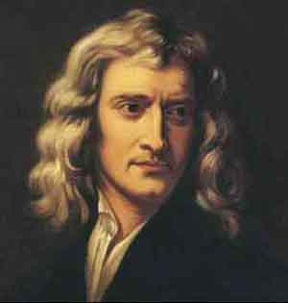
Newton

Slide 31
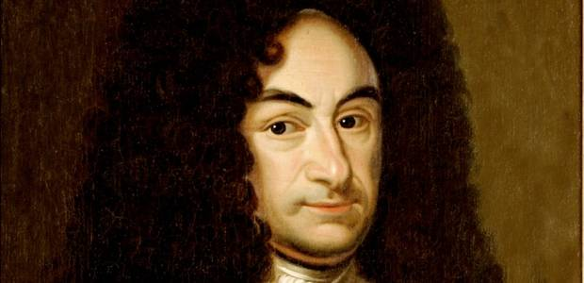
Leibniz

Slide 32
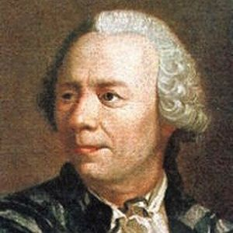
Leonhard Euler

Slide 33
Games
Calculate e and π as precisely as you can
Compute $\sum_{n=1}^{∞}{\frac{1}{2^{n}}}$
Bernoulli experiments
Hangover problems

Slide 34
Number theory
An irrational number is any real number that cannot be expressed as a ratio of integers. Informally, this means that an irrational number cannot be represented as a simple fraction. Irrational numbers are those real numbers that cannot be represented as terminating or repeating decimals. Real numbers are uncountable (and the rationals countable) it follows that almost all real numbers are irrational.
Perhaps the best-known irrational numbers are: the ratio of a circle's circumference to its diameter π, Euler's number e, the golden ratio φ, and the square root of two.

Slide 35
Function
A function is a relation between a set of inputs and a set of permissible outputs with the property that each input is related to no more than one output.

Slide 36
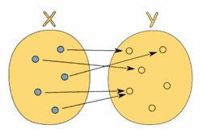
Is this a function or not?

Slide 37
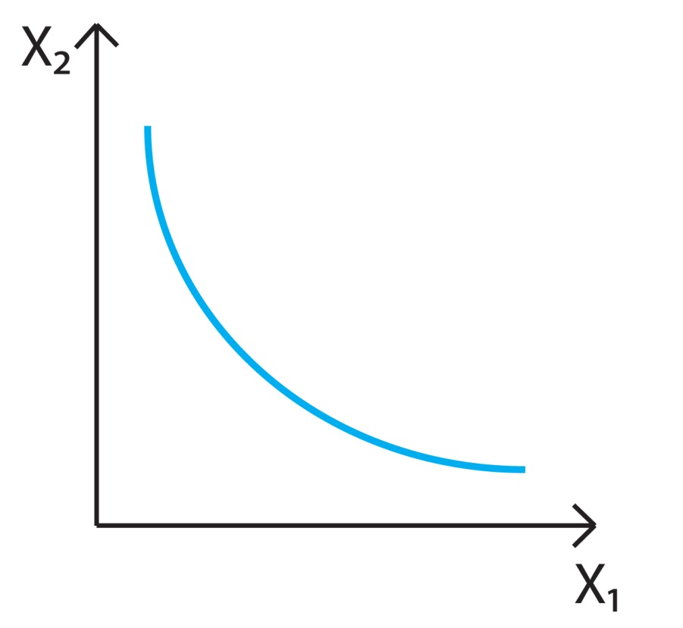
Is this a function or not?

Slide 38
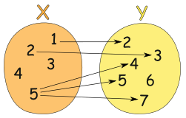
Is this a function or not?

Slide 39
Limit
A limit is the value that a function approaches as the input approaches some value.

Slide 40
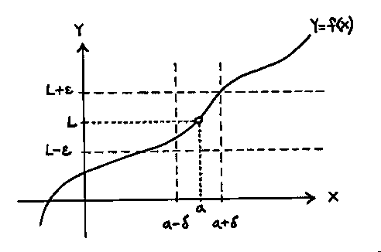
Limit

Slide 42
Continuity
A continuous function is a function for which small changes in the input result in small changes in the output.

Slide 43
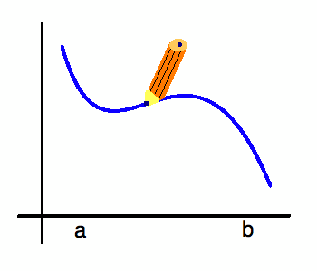
Continuity

Slide 44
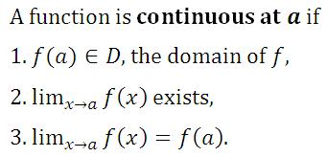

Slide 45
Derivative
The derivative of a function of a real variable measures the sensitivity to change of a quantity (a function or dependent variable) which is determined by another quantity (the independent variable). It is a fundamental tool of calculus. For example, the derivative of the position of a moving object with respect to time is the object's velocity: this measures how quickly the position of the object changes when time is advanced. The derivative measures the instantaneous rate of change of the function, as distinct from its average rate of change, and is defined as the limit of the average rate of change in the function as the length of the interval on which the average is computed tends to zero.
The derivative of a function at a chosen input value describes the best linear approximation of the function near that input value. In fact, the derivative at a point of a function of a single variable is the slope of the tangent line to the graph of the function at that point.
The notion of derivative may be generalized to functions of several real variables. The generalized derivative is a linear map called the differential. Its matrix representation is the Jacobian matrix, which reduces to the gradient vector in the case of real-valued function of several variables.
The process of finding a derivative is called differentiation. The reverse process is called antidifferentiation. The fundamental theorem of calculus states that antidifferentiation is the same as integration. Differentiation and integration constitute the two fundamental operations in single-variable calculus.

Slide 46
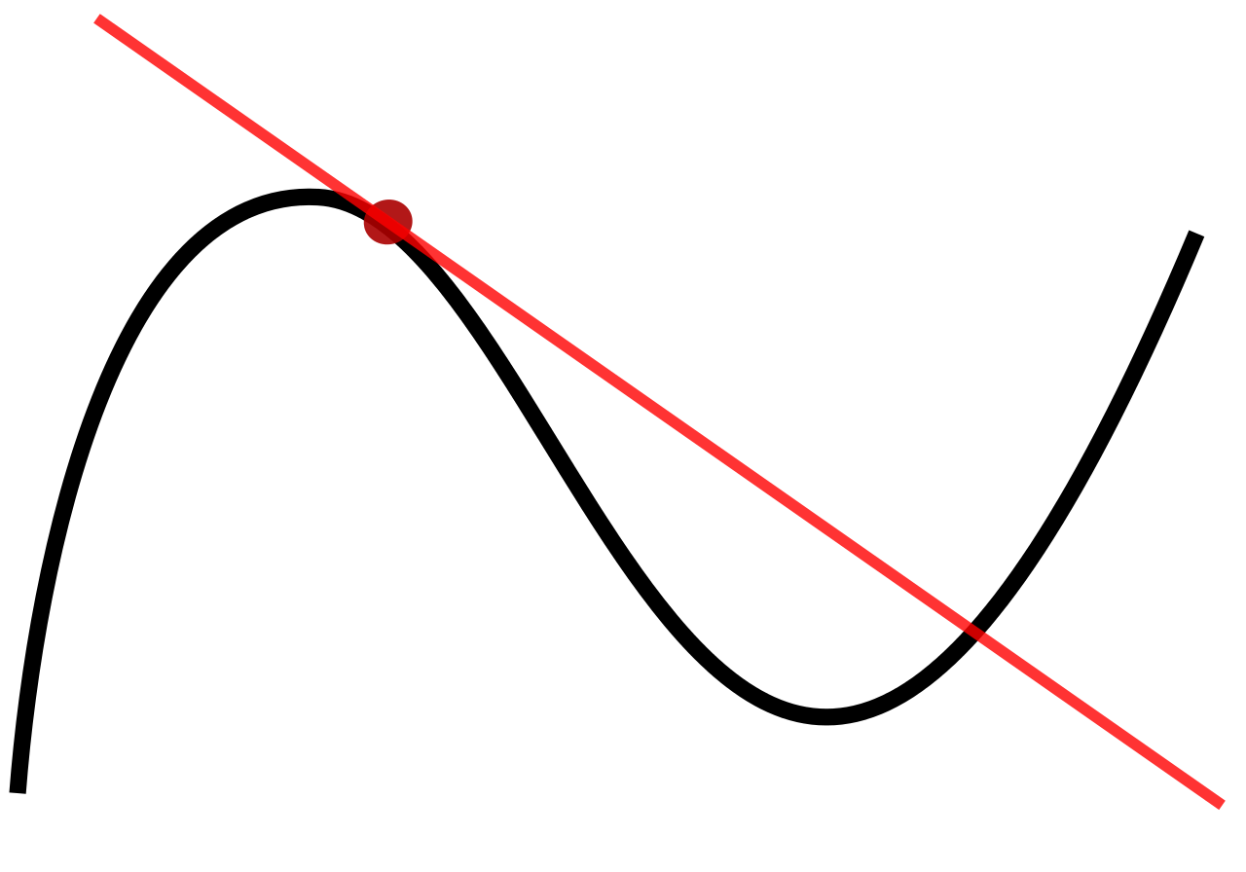
Derivative

Slide 47
Derivative

Slide 48
Exercises
1. Define calculus.
2. Why do we need to study calculus?
3. How do we use calculus in everyday life?
4. What is an infinitely small value?

Slide 49
Exercises
5. Write, which numbers are whole, natural, rational, irrational, real and complex.
a. Ln(7)
b. 3 – 2i
c. -9
d. 3

Slide 50
Exercises
6. Define a function.
7. What functions are continuous?
8. What is limit of function?
9. Define derivative.
10. What is integral?
11. Define series.

Slide 51
Exercises
12. Calculate e and π as precisely as you can.
13. Compute $\sum_{n=1}^{∞}{\frac{1}{2^{n}}}$

Slide 52
Bibliography:
[Textbooks] http://calculus12s.weebly.com/
[WikiPedia] http://en.wikipedia.org
[Google] https://www.google.com
[WolframMathWorld] wolfram.com

