Slide 1
Calculus 2 Lecture
Review/Revision
Limit
Continuity
Derivative
Integral
Applications of derivatives and integrals

Slide 2
Review/Revision
Quantifiers:
Universal quantification (for all)
Existential quantification (there exist)

Slide 3
Universal quantification
A universal quantification is a type of quantifier, a logical constant which is interpreted as "given any" or "for all". It expresses that a propositional function can be satisfied by every member of a domain of discourse. In other terms, it is the predication of a property or relation to every member of the domain. It asserts that a predicate within the scope of a universal quantifier is true of every value of a predicate variable.
It is usually denoted by the turned A (∀) logical operator symbol, which, when used together with a predicate variable, is called a universal quantifier ("∀x", "∀(x)", or sometimes by "(x)" alone). Universal quantification is distinct from existential quantification ("there exists"), which asserts that the property or relation holds only for at least one member of the domain.

Slide 4
Existential quantification
An existential quantification is a type of quantifier, a logical constant which is interpreted as "there exists," "there is at least one," or "for some." It expresses that a propositional function can be satisfied by at least one member of a domain of discourse. In other terms, it is the predication of a property or relation to at least one member of the domain. It asserts that a predicate within the scope of an existential quantifier is true of at least one value of a predicate variable.
It is usually denoted by the turned E (∃) logical operator symbol, which, when used together with a predicate variable, is called an existential quantifier ("∃x" or "∃(x)").

Slide 5
Review/Revision
Relevant number theory problems:
Geometrical progression series
Converting recurring decimals to fractions
Powers
Etc.

Slide 6
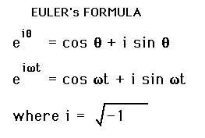
Euler’s formula

Slide 7
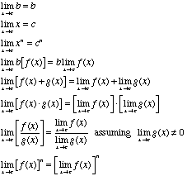
Limits properties

Slide 8
Limit
Compute π using different methods

Slide 9
Continuous function
A continuous function is, roughly speaking, a function for which small changes in the input result in small changes in the output. Otherwise, a function is said to be a discontinuous function.

Slide 10
Continuity
Is continuity necessary for differentiability?

Slide 11
Differentiability vs. continuity
Is differentiability sufficient for continuity?

Slide 12
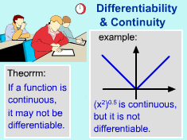
Differentiability vs. continuity

Slide 13
Differentiability
A differentiable function of one real variable is a function whose derivative exists at each point in its domain. As a result, the graph of a differentiable function must have a non-vertical tangent line at each point in its domain, be relatively smooth, and cannot contain any breaks, bends, or cusps.

Slide 14
Draw graphs of functions, which are differentiable and which are not.

Slide 15
Derivative
The derivative of a function of a real variable measures the sensitivity to change of a quantity (a function or dependent variable) which is determined by another quantity (the independent variable). It is a fundamental tool of calculus. For example, the derivative of the position of a moving object with respect to time is the object's velocity: this measures how quickly the position of the object changes when time is advanced. The derivative measures the instantaneous rate of change of the function, as distinct from its average rate of change, and is defined as the limit of the average rate of change in the function as the length of the interval on which the average is computed tends to zero.

Slide 16
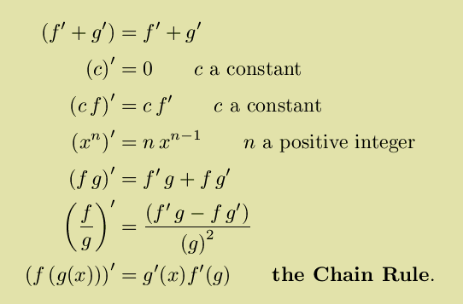
Derivatives properties

Slide 17
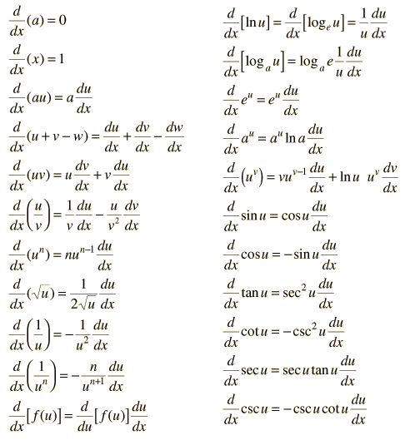
Derivatives

Slide 18
Derivatives proofs

Slide 19
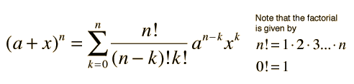
Binomial expansion

Slide 20
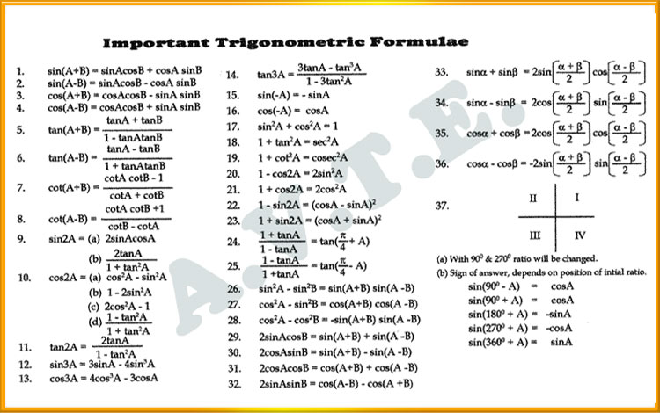
Trigonometric formulas

Slide 21
Partial derivative
A partial derivative of a function of several variables is its derivative with respect to one of those variables, with the others held constant (as opposed to the total derivative, in which all variables are allowed to vary).

Slide 22
One-to-one function
A function for which every element of the range of the function corresponds to exactly one element of the domain. One-to-one is often written 1-1.
Note: y = f(x) is a function if it passes the vertical line test. It is a 1-1 function if it passes both the vertical line test and the horizontal line test.

Slide 23
Only one-to-one function has inverse function. Why?

Slide 24
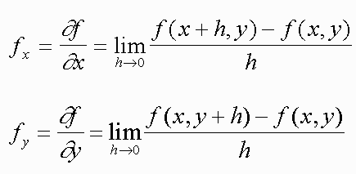
Partial derivative

Slide 25
Inverse function
An inverse function is a function that "reverses" another function: if the function f applied to an input x gives a result of y, then applying its inverse function g to y gives the result x, and vice versa. i.e., f(x) = y if and only if g(y) = x.

Slide 26

Inverse function derivative

Slide 27
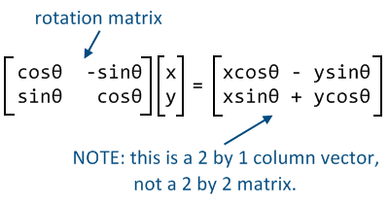
Rotation matrix

Slide 28

Implicit function derivative

Slide 29
Implicit function
A function or relation in which the dependent variable is not isolated on one side of the equation.

Slide 30
Differential
The differential represents the principal part of the change in a function y = f(x) with respect to changes in the independent variable.

Slide 31
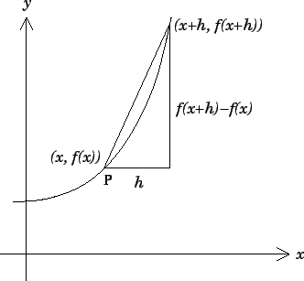
Differential

Slide 32
L'Hôpital's rule
l'Hôpital's rule (pronounced: [lopiˈtal]) uses derivatives to help evaluate limits involving indeterminate forms. Application (or repeated application) of the rule often converts an indeterminate form to a determinate form, allowing easy evaluation of the limit. The rule is named after the 17th-century French mathematician Guillaume de l'Hôpital (also written l'Hospital), who published the rule in his 1696 book Analyse des Infiniment Petits pour l'Intelligence des Lignes Courbes (literal translation: Analysis of the Infinitely Small for the Understanding of Curved Lines), the first textbook on differential calculus.However, it is believed that the rule was discovered by the Swiss mathematician Johann Bernoulli.

Slide 33
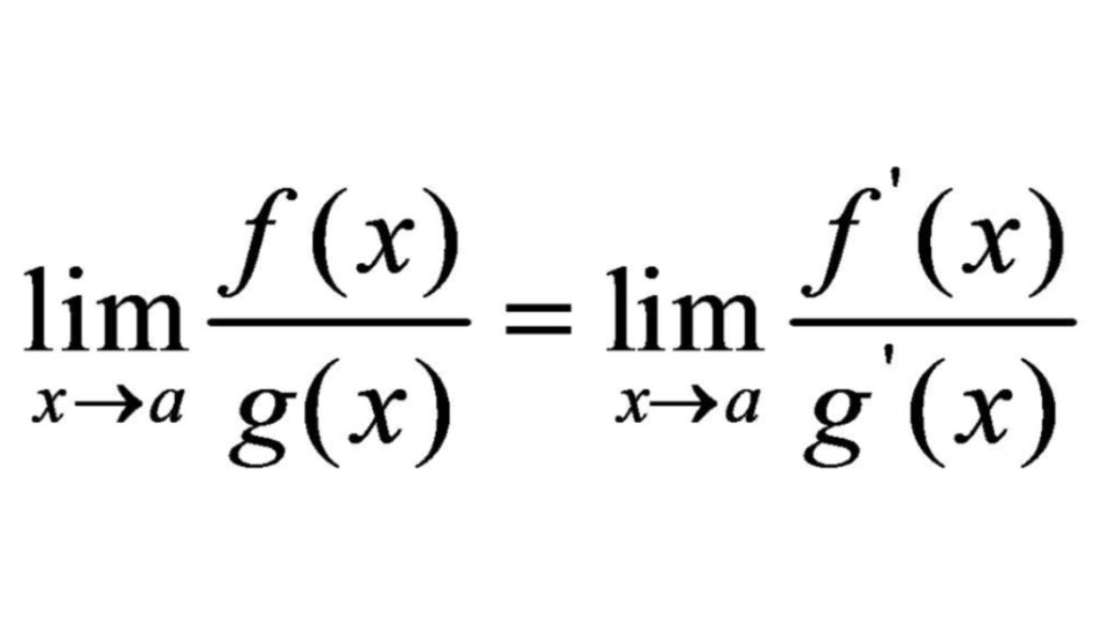
L'Hôpital's rule

Slide 34
Limits proofs using L'Hôpital's rule

Slide 35
Taylor’s series
A Taylor series is a representation of a function as an infinite sum of terms that are calculated from the values of the function's derivatives at a single point.
The concept of a Taylor series was discovered by the Scottish mathematician James Gregory and formally introduced by the English mathematician Brook Taylor in 1715. If the Taylor series is centered at zero, then that series is also called a Maclaurin series, named after the Scottish mathematician Colin Maclaurin, who made extensive use of this special case of Taylor series in the 18th century.
It is common practice to approximate a function by using a finite number of terms of its Taylor series. Taylor's theorem gives quantitative estimates on the error in this approximation. Any finite number of initial terms of the Taylor series of a function is called a Taylor polynomial. The Taylor series of a function is the limit of that function's Taylor polynomials, provided that the limit exists. A function may not be equal to its Taylor series, even if its Taylor series converges at every point. A function that is equal to its Taylor series in an open interval (or a disc in the complex plane) is known as an analytic function in that interval.

Slide 36
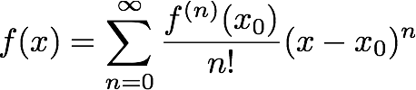
Taylor’s series

Slide 37
Antiderivative
An antiderivative, primitive integral or indefinite integral of a function f is a differentiable function F whose derivative is equal to f, i.e., F ′ = f. The process of solving for antiderivatives is called antidifferentiation (or indefinite integration) and its opposite operation is called differentiation, which is the process of finding a derivative. Antiderivatives are related to definite integrals through the fundamental theorem of calculus: the definite integral of a function over an interval is equal to the difference between the values of an antiderivative evaluated at the endpoints of the interval.

Slide 38
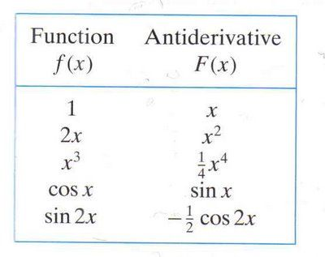
Antiderivatives

Slide 39
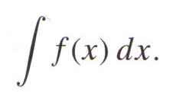
Indefinite integral

Slide 40
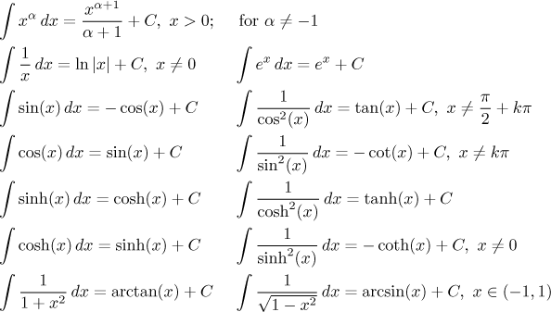
Integrals

Slide 41
Riemann sum
A Riemann sum is an approximation of the area of a region, often the region underneath a curve. It is named after German mathematician Bernhard Riemann.
The sum is calculated by dividing the region up into shapes (rectangles or trapezoids) that together form a region that is similar to the region being measured, then calculating the area for each of these shapes, and finally adding all of these small areas together. This approach can be used to find a numerical approximation for a definite integral even if the fundamental theorem of calculus does not make it easy to find a closed-form solution.
Because the region filled by the small shapes is usually not exactly the same shape as the region being measured, the Riemann sum will differ from the area being measured. This error can be reduced by dividing up the region more finely, using smaller and smaller shapes. As the shapes get smaller and smaller, the sum approaches the Riemann integral.

Slide 42
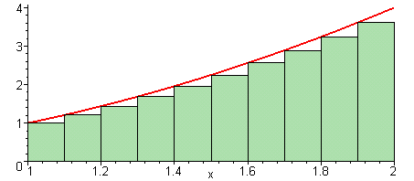
Riemann sum

Slide 43
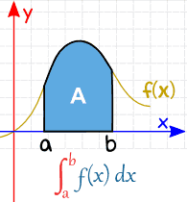
Definite integral

Slide 44
Integration by substitution
Integration by substitution, also known as u-substitution, is a method for finding integrals. Using the fundamental theorem of calculus often requires finding an antiderivative. For this and other reasons, integration by substitution is an important tool for mathematicians. It is the counterpart to the chain rule of differentiation.

Slide 45
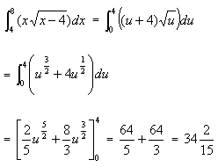
Integration by substitution

Slide 46
Integration by parts
Integration by parts is a theorem that relates the integral of a product of functions to the integral of their derivative and antiderivative. It is frequently used to transform the antiderivative of a product of functions into an antiderivative for which a solution can be more easily found. The rule can be derived in one line simply by integrating the product rule of differentiation.

Slide 47
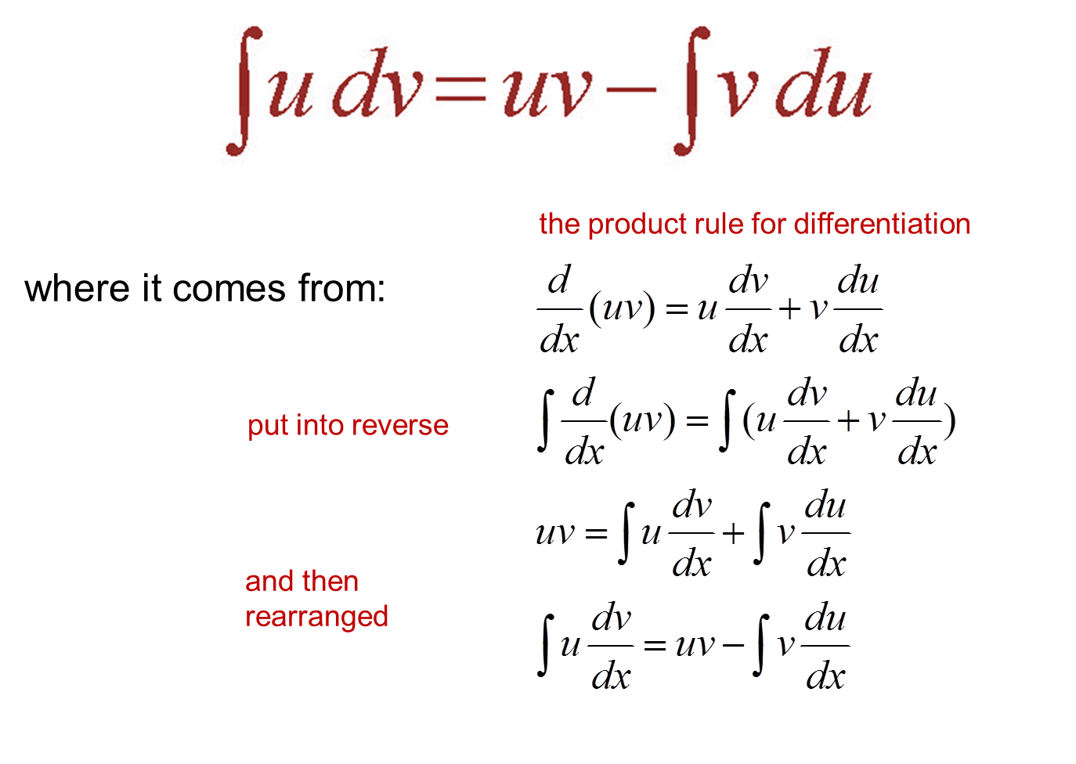
Integration by parts

Slide 48
Fibonacci Golden Ratio is one of the links between calculus and discrete math.

Slide 49
Why do we use discrete math in calculus?

Slide 50
Numerical integration
Numerical integration constitutes a broad family of algorithms for calculating the numerical value of a definite integral, and by extension, the term is also sometimes used to describe the numerical solution of differential equations. This article focuses on calculation of definite integrals. The term numerical quadrature (often abbreviated to quadrature) is more or less a synonym for numerical integration, especially as applied to one-dimensional integrals. Numerical integration over more than one dimension is sometimes described as cubature, although the meaning of quadrature is understood for higher-dimensional integration as well.

Slide 51
Improper integral
An improper integral is the limit of a definite integral as an endpoint of the interval(s) of integration approaches a specified real number or, in some cases, as both endpoints approach limits. Such an integral is often written symbolically just like a standard definite integral, perhaps with infinity as a limit of integration.

Slide 52
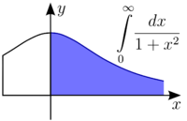
Improper integral

Slide 53

Integrable singularity

Slide 54
Non-integrable singularity

Slide 55
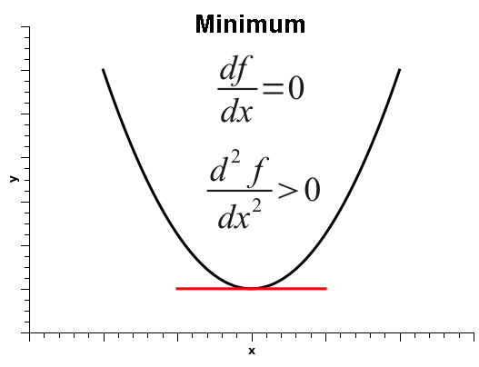

Slide 56
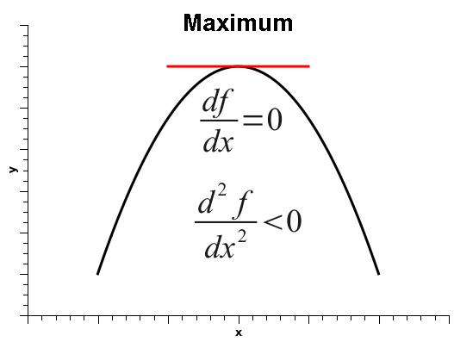

Slide 57
Inflection point
An inflection point, point of inflection, flex, or inflection (inflexion) is a point on a curve at which the curvature or concavity changes sign from plus to minus or from minus to plus. The curve changes from being concave (positive curvature) to convex (negative curvature), or vice versa.
A point where the curvature vanishes but does not change sign is sometimes called a point of undulation or undulation point.
In algebraic geometry an inflection point is defined slightly more generally, as a point where the tangent meets the curve to order at least 3, and an undulation point or hyperflex is defined as a point where the tangent meets the curve to order at least 4.

Slide 58
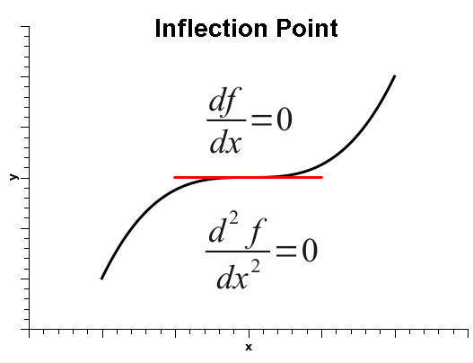

Slide 59
Plotting graphs of functions

Slide 60
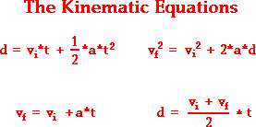
Kinematics

Slide 61
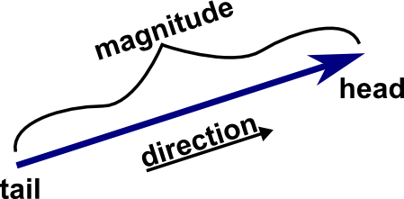
Vector

Slide 62
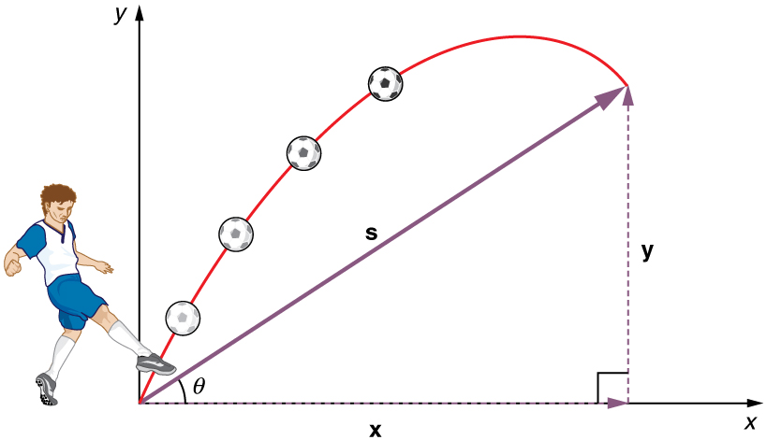
Projectile

Slide 63
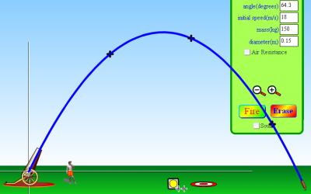
Projectile

Slide 64
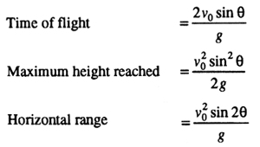
Projectile equations

Slide 65
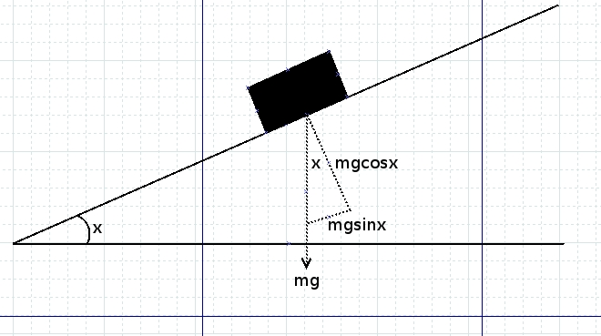
Dynamics

Slide 66
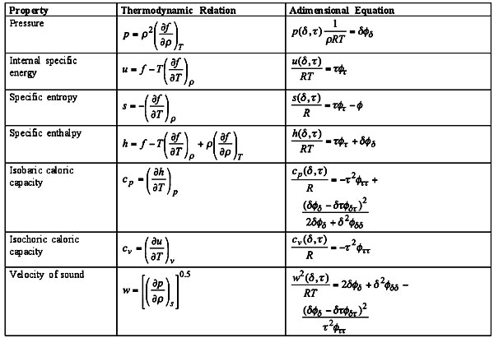
Thermodynamics

Slide 67
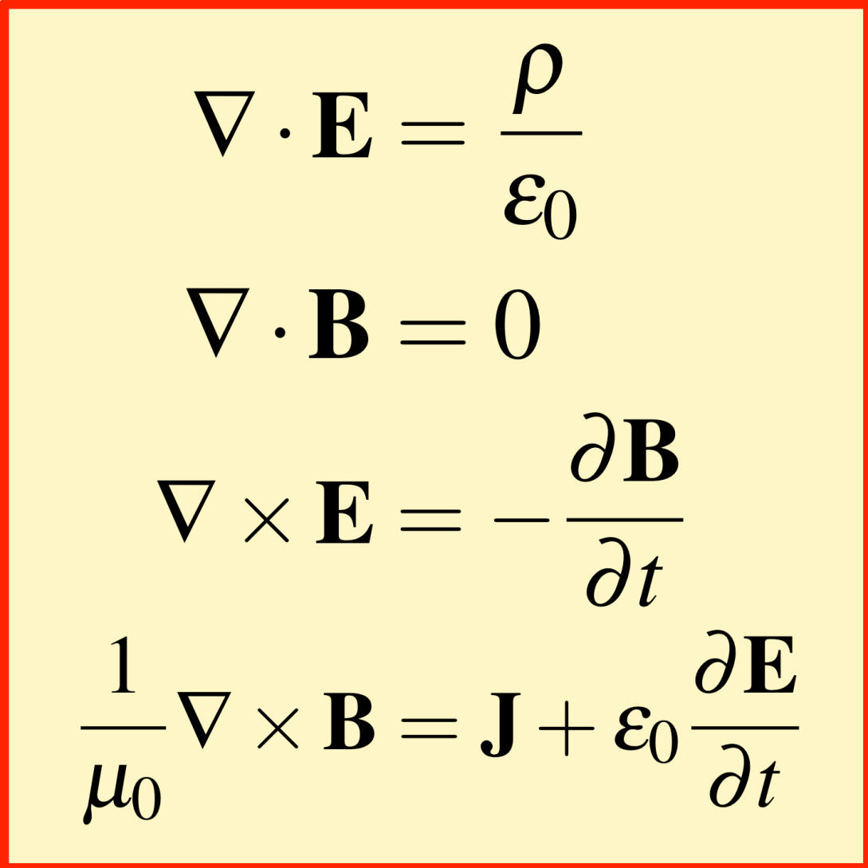
Electromagnetism

Slide 68
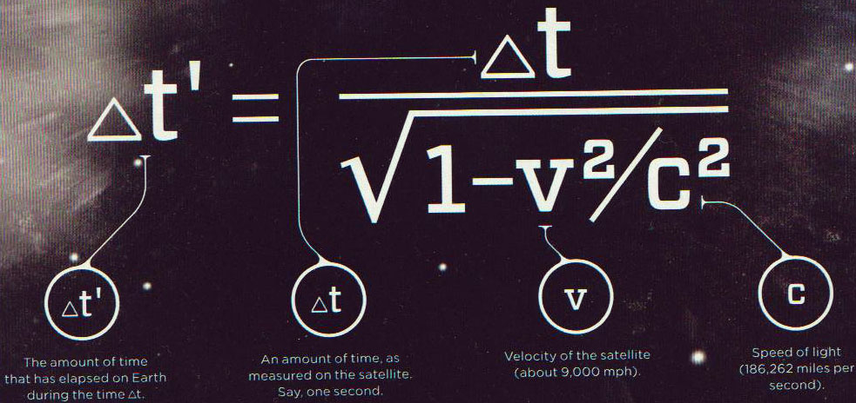
Special relativity theory

Slide 69
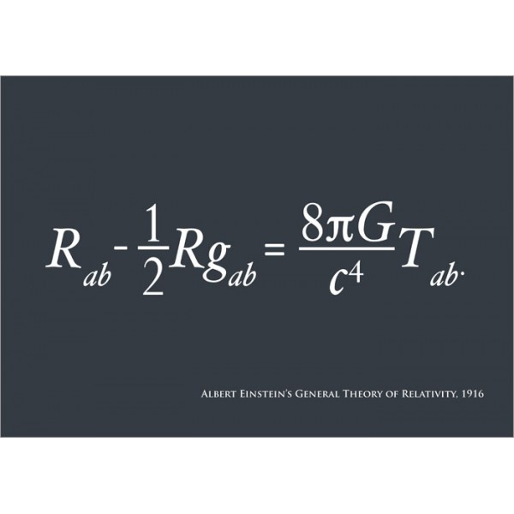
Relativity theory (General)

Slide 70
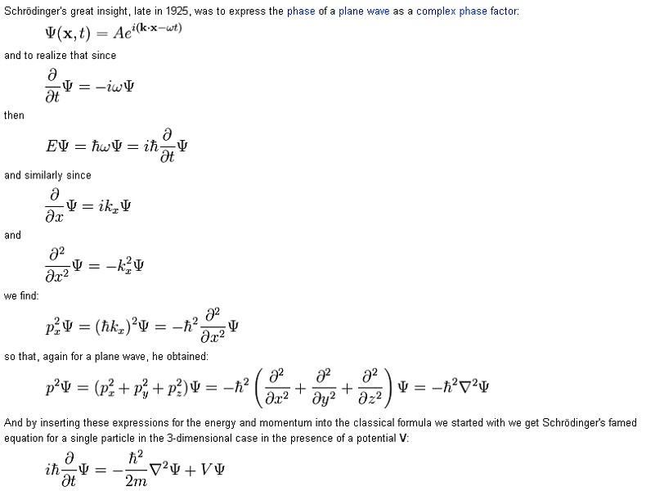
Quantum physics

