Slide 1
3 Lecture in calculus
Differentiability
Total derivative
Integral
Calculus Fundamental theorem
Kepler's laws
Moment
Sets theory

Slide 2
Intermediate value theorem
The intermediate value theorem states that if a continuous function f with an interval [a, b] as its domain takes values f(a) and f(b) at each end of the interval, then it also takes any value between f(a) and f(b) at some point within the interval. This has two important specializations: If a continuous function has values of opposite sign inside an interval, then it has a root in that interval (Bolzano's theorem).And, the image of a continuous function over an interval is itself an interval.

Slide 3
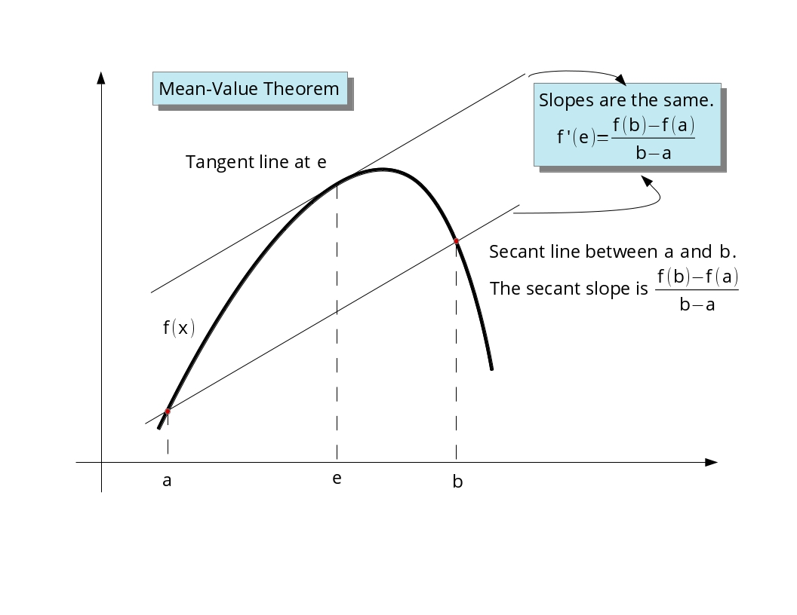
Intermediate value theorem

Slide 4
Differentiability
A differentiable function of one real variable is a function whose derivative exists at each point in its domain. As a result, the graph of a differentiable function must have a non-vertical tangent line at each point in its domain, be relatively smooth, and cannot contain any breaks, bends, or cusps.
More generally, if x₀ is a point in the domain of a function f, then f is said to be differentiable at x₀ if the derivative f′(x₀) exists. This means that the graph of f has a non-vertical tangent line at the point (x₀, f(x₀)). The function f may also be called locally linear at x₀, as it can be well approximated by a linear function near this point.

Slide 5
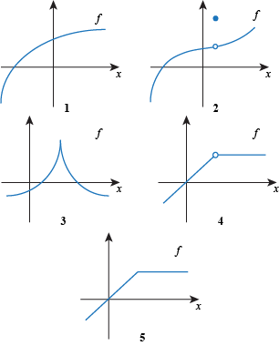
Differentiability

Slide 6
Rolle's theorem
Rolle's theorem essentially states that any real-valued differentiable function that attains equal values at two distinct points must have a stationary point somewhere between them; that is, a point where the first derivative (the slope of the tangent line to the graph of the function) is zero.

Slide 7
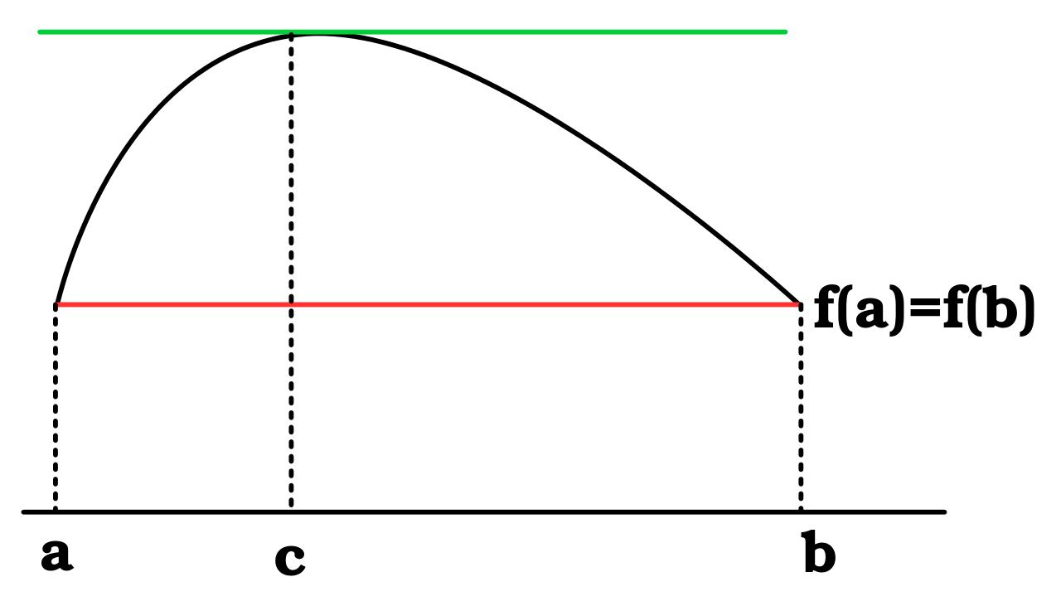
Rolle's theorem

Slide 8
Fermat's theorem (stationary points)
Fermat's theorem (not to be confused with Fermat's last theorem) is a method to find local maxima and minima of differentiable functions on open sets by showing that every local extremum of the function is a stationary point (the function derivative is zero in that point). Fermat's theorem is a theorem in real analysis, named after Pierre de Fermat.

Slide 9
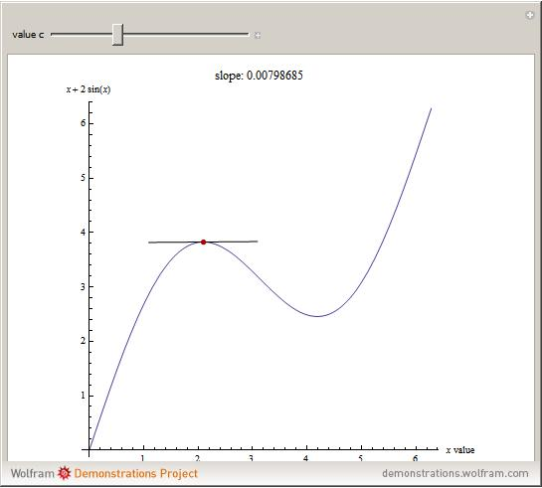
Fermat's theorem (stationary points)

Slide 10
Total derivative

Slide 11
Implicit function derivative
Implicit function derivative using total derivative

Slide 12
Gradient
The gradient is a generalization of the usual concept of derivative of a function in one dimension to a function in several dimensions.

Slide 13
Divergence
Divergence is a vector operator that measures the magnitude of a vector field's source or sink at a given point, in terms of a signed scalar. More technically, the divergence represents the volume density of the outward flux of a vector field from an infinitesimal volume around a given point.

Slide 14
Nabla operator
Nabla, is an operator used in mathematics, in particular, in vector calculus, as a vector differential operator.

Slide 15
Laplace operator
The Laplace operator or Laplacian is a differential operator given by the divergence of the gradient of a function on Euclidean space.

Slide 16
Antiderivative
An antiderivative, primitive integral or indefinite integral of a function f is a differentiable function F whose derivative is equal to f, i.e., F ′ = f. The process of solving for antiderivatives is called antidifferentiation (or indefinite integration) and its opposite operation is called differentiation, which is the process of finding a derivative. Antiderivatives are related to definite integrals through the fundamental theorem of calculus: the definite integral of a function over an interval is equal to the difference between the values of an antiderivative evaluated at the endpoints of the interval.
The discrete equivalent of the notion of antiderivative is antidifference.

Slide 17
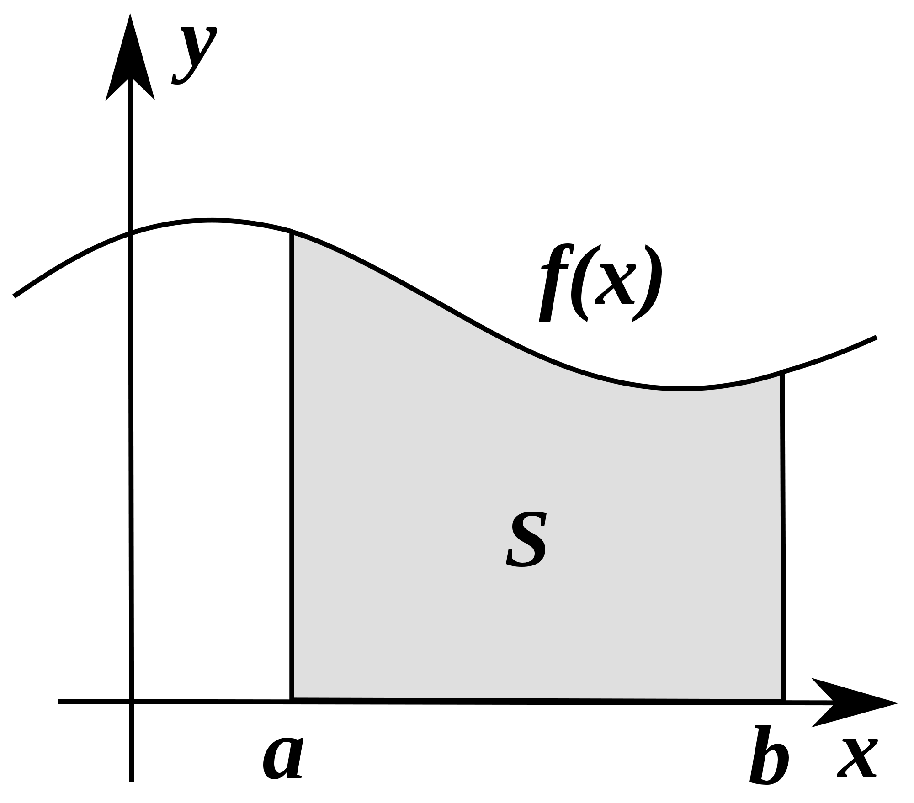
Definite integral as area

Slide 18
Fundamental theorem of calculus
The fundamental theorem of calculus is a theorem that links the concept of the derivative of a function with the concept of the integral.
The first part of the theorem, sometimes called the first fundamental theorem of calculus, is that an indefinite integral of a function can be reversed by differentiation. This part of the theorem is also important because it guarantees the existence of antiderivatives for continuous functions.
The second part, sometimes called the second fundamental theorem of calculus, is that the definite integral of a function can be computed by using any one of its infinitely many antiderivatives. This part of the theorem has key practical applications because it markedly simplifies the computation of definite integrals.

Slide 19
Fundamental theorem of calculus

Slide 20
Integrals, which cannot be computed
Non-computable integrals

Slide 21
Average Function Value
The average value of a function f(x) over the interval [a,b] is given by the integral.

Slide 22
Solid of revolution
A solid of revolution is a solid figure obtained by rotating a plane curve around some straight line (the axis) that lies on the same plane.
Assuming that the curve does not cross the axis, the solid's volume is equal to the length of the circle described by the figure's centroid multiplied by the figure's area (Pappus's second centroid Theorem).
A representative disk is a three-dimensional volume element of a solid of revolution. The element is created by rotating a line segment (of length w) around some axis (located r units away), so that a cylindrical volume of πr²w units is enclosed.

Slide 23
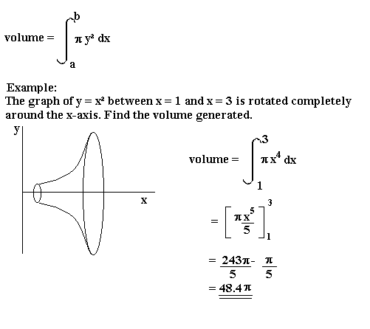
Solid of revolution

Slide 24
Mass center
The center of mass of a distribution of mass in space is the unique point where the weighted relative position of the distributed mass sums to zero. The distribution of mass is balanced around the center of mass and the average of the weighted position coordinates of the distributed mass defines its coordinates. Calculations in mechanics are often simplified when formulated with respect to the center of mass.

Slide 25
Mass center (continued)
In the case of a single rigid body, the center of mass is fixed in relation to the body, and if the body has uniform density, it will be located at the centroid. The center of mass may be located outside the physical body, as is sometimes the case for hollow or open-shaped objects, such as a horseshoe. In the case of a distribution of separate bodies, such as the planets of the Solar System, the center of mass may not correspond to the position of any individual member of the system.

Slide 26
(continued) Mass center
The center of mass is a useful reference point for calculations in mechanics that involve masses distributed in space, such as the linear and angular momentum of planetary bodies and rigid body dynamics. In orbital mechanics, the equations of motion of planets are formulated as point masses located at the centers of mass. The center of mass frame is an inertial frame in which the center of mass of a system is at rest with respect to the origin of the coordinate system.

Slide 27
Mass center

Slide 28
Integration error bounds or truncation error
rectangles
trapezoids
Simpson’s

Slide 29
Ellipse
An ellipse is a curve on a plane surrounding two focal points such that a straight line drawn from one of the focal points to any point on the curve and then back to the other focal point has the same length for every point on the curve. As such, it is a generalization of a circle, which is a special type of an ellipse that has both focal points at the same location. The shape of an ellipse (how 'elongated' it is) is represented by its eccentricity, which for an ellipse can be any number from 0 (the limiting case of a circle) to arbitrarily close to but less than 1.

Slide 30
Ellipse (continued)
Ellipses are the closed type of conic section: a plane curve that results from the intersection of a cone by a plane. (See figure to the right.) Ellipses have many similarities with the other two forms of conic sections: the parabolas and the hyperbolas, both of which are open and unbounded. The cross section of a cylinder is an ellipse if it is sufficiently far from parallel to the axis of the cylinder.

Slide 31
(continued) Ellipse
Analytically, an ellipse can also be defined as the set of points such that the ratio of the distance of each point on the curve from a given point (called a focus or focal point) to the distance from that same point on the curve to a given line (called the directrix) is a constant, called the eccentricity of the ellipse.

Slide 32
Ellipse (continued)
Ellipses are common in physics, astronomy and engineering. For example, the orbits of the planets are ellipses with the Sun at one of the focal points. The same is true for moons orbiting planets and all other systems having two astronomical bodies. The shape of planets and stars are often well described by ellipsoids. Ellipses also arise as images of a circle under parallel projection and the bounded cases of perspective projection, which are simply intersections of the projective cone with the plane of projection. It is also the simplest Lissajous figure, formed when the horizontal and vertical motions are sinusoids with the same frequency. A similar effect leads to elliptical polarization of light in optics.

Slide 33
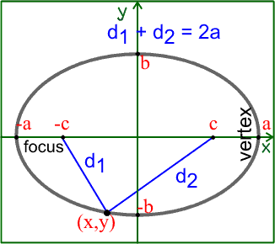
(continued) Ellipse

Slide 34
Kepler's laws
Kepler's laws of planetary motion are three scientific laws describing the motion of planets around the Sun. Kepler's laws are now traditionally enumerated in this way:
1. The orbit of a planet is an ellipse with the Sun at one of the two foci.
2. A line segment joining a planet and the Sun sweeps out equal areas during equal intervals of time.
3. The square of the orbital period of a planet is proportional to the cube of the semi-major axis of its orbit.

Slide 35
Kepler's laws(continued)
Most planetary orbits are almost circles, so it is not apparent that they are actually ellipses. Calculations of the orbit of the planet Mars first indicated to Kepler its elliptical shape, and he inferred that other heavenly bodies, including those farther away from the Sun, have elliptical orbits also. Kepler's work broadly followed the heliocentric theory of Nicolaus Copernicus by asserting that the Earth orbited the Sun. It innovated in explaining how the planets' speeds varied, and using elliptical orbits rather than circular orbits with epicycles.
Isaac Newton showed in 1687 that relationships like Kepler's would apply in the solar system to a good approximation, as consequences of his own laws of motion and law of universal gravitation. Together with Newton's theories, Kepler's laws became part of the foundation of modern astronomy and physics.

Slide 36
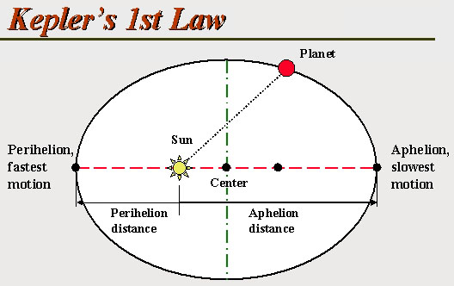
Kepler's law 1

Slide 37
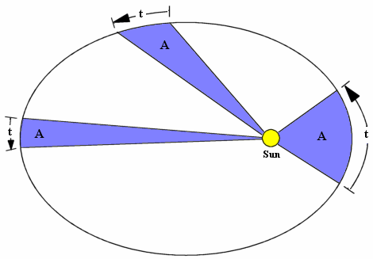
Kepler's law 2

Slide 38
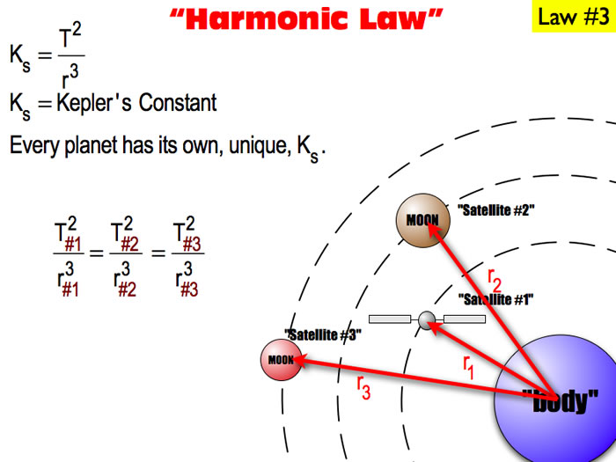
Kepler's laws 3

Slide 39
Vectors
Dot product
Cross product

Slide 40
Moment
Moment is a combination of a physical quantity and a distance. Moments are usually defined with respect to a fixed reference point; they deal with physical quantities as measured at some distance from that reference point. For example, a moment of force is the product of a force and its distance from an axis, which causes rotation about that axis. In principle, any physical quantity can be combined with a distance to produce a moment; commonly used quantities include forces, masses, and electric charge distributions.

Slide 41
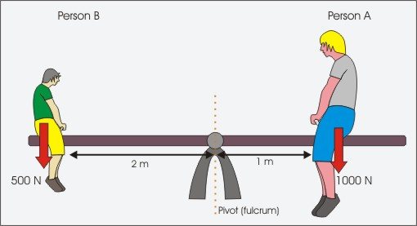
Moment

Slide 42
Block stacking
The block-stacking problem (also the book-stacking problem, or a number of other similar terms) is the following puzzle:
Place rigid rectangular blocks in a stable stack on a table edge in such a way as to maximize the overhang.

Slide 43
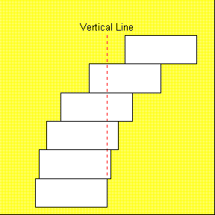
Block stacking

Slide 44
Set theory
Set theory is the branch of mathematical logic that studies sets, which are collections of objects. Although any type of object can be collected into a set, set theory is applied most often to objects that are relevant to mathematics. The language of set theory can be used in the definitions of nearly all mathematical objects.

Slide 45
Set theory (continued)
The modern study of set theory was initiated by Georg Cantor and Richard Dedekind in the 1870s. After the discovery of paradoxes in naive set theory, numerous axiom systems were proposed in the early twentieth century, of which the Zermelo–Fraenkel axioms, with the axiom of choice, are the best-known.

Slide 46
(continued) Set theory
Set theory is commonly employed as a foundational system for mathematics, particularly in the form of Zermelo–Fraenkel set theory with the axiom of choice. Beyond its foundational role, set theory is a branch of mathematics in its own right, with an active research community. Contemporary research into set theory includes a diverse collection of topics, ranging from the structure of the real number line to the study of the consistency of large cardinals.

Slide 47
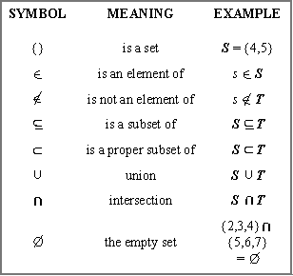
Set theory (continued)

Slide 48
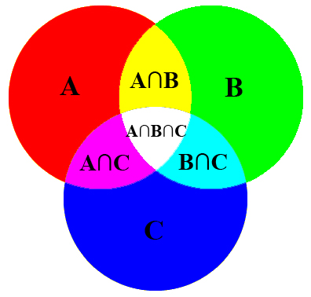
(continued) Set theory

Slide 49
Cardinality
The cardinality of a set is a measure of the "number of elements of the set". For example, the set A = {2, 4, 6} contains 3 elements, and therefore A has a cardinality of 3. There are two approaches to cardinality – one which compares sets directly using bijections and injections, and another which uses cardinal numbers. The cardinality of a set is also called its size, when no confusion with other notions of size is possible.
The cardinality of a set A is usually denoted | A |, with a vertical bar on each side; this is the same notation as absolute value and the meaning depends on context. Alternatively, the cardinality of a set A may be denoted by n(A), A, card(A), or # A.

Slide 50
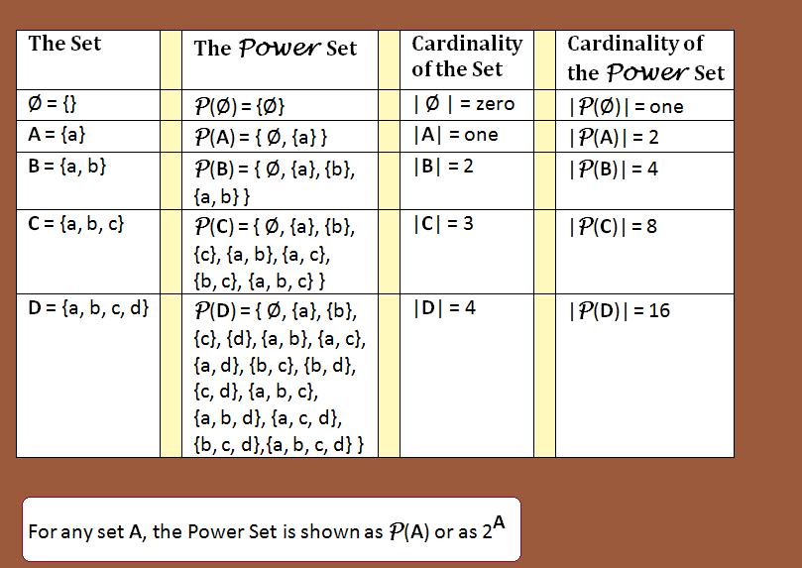
Cardinality (continued)

Slide 51
3 Exercises
1. Explain differentiability and its relation to continuity. Give examples of differentiable functions and not differentiable functions.
2. Define total derivative.
3. Prove the implicit function derivative equation using total derivative.
4. Which problem is more complex, differentiation or integration and why?
5. Define Riemann sums and a definite integral.
6. Formulate Calculus Fundamental Theorem.
7. Explain integration by substitution and by parts.

Slide 52
3 Exercises
8. Calculate these integrals.
a. $\int_{4}^{9}{\left({2e}^{x}−\frac{7}{x}\right)dx}$
b. $\int_{1}^{2}{x\sqrt{x+1}dx}$
c. $\int_{4}^{7}{x sin⁡(x) dx}$

Slide 53
3 Exercises
9. Prove the equation for the volume of a cone using integration.
10. Find the center of mass of each of these shapes.
a. y = x, x  [0, 1]
b. y = 2x, x  [0, 1]
c. y = x³, x  [0, 1]
11. Explain the main theorems of calculus.
12. List some integrals, which cannot be computed.

