Slide 1
4 Lecture in calculus
Numerical integration
Multiple integrals
Improper integrals
Equations integration
Conic sections
Quadratic surfaces

Slide 2
Debate
Debate competitions are 10% of our scores.
Register today
Use your calculus knowledge in the debate

Slide 3
Missed:
Thread failure in rotational motion trajectory
Mistake in harmonic oscillator
f*f=k/m,
x = A cos (f*t)
T=2π$\sqrt{\frac{m}{k}}$
T=2π$\sqrt{\frac{L}{g}}$
Pendulum equations
Angular momentum through moment of inertia and angular velocity

Slide 4
Numerical integration:
Rectangular rule
Trapezoidal rule
Simpsons rule

Slide 5
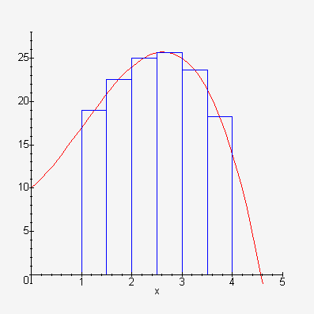
Rectangular rule

Slide 6
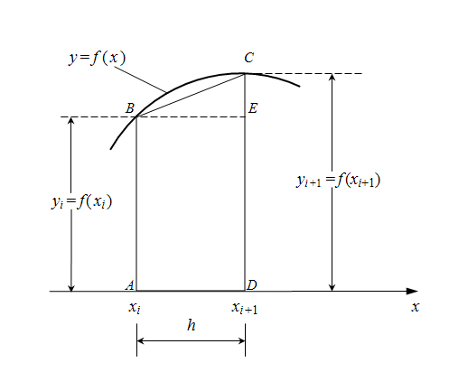
Trapezoidal rule

Slide 7
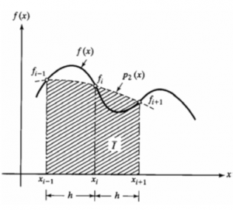
Simpsons rule

Slide 8
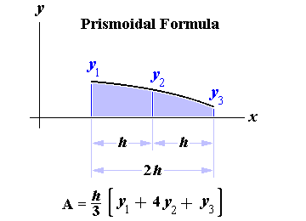
Simpsons rule

Slide 9
Damping
Damping is an influence within or upon an oscillatory system that has the effect of reducing, restricting or preventing its oscillations. In physical systems, damping is produced by processes that dissipate the energy stored in the oscillation. Examples include viscous drag in mechanical systems, resistance in electronic oscillators, and absorption and scattering of light in optical oscillators. Damping not based on energy loss can be important in other oscillating systems such as those that occur in biological systems.

Slide 10
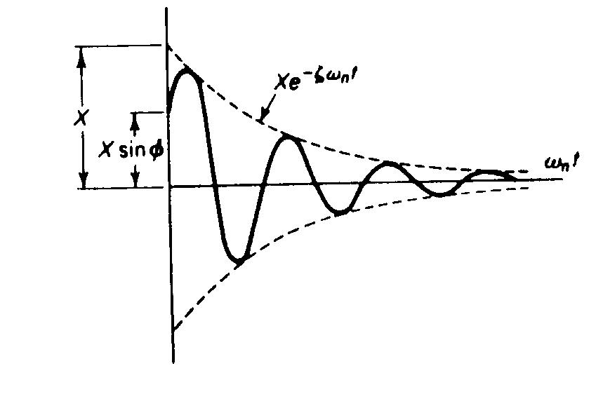
Damping

Slide 11
Multivariable calculus
Multivariable calculus (also known as multivariate calculus) is the extension of calculus in one variable to calculus in more than one variable: the differentiation and integration of functions involving multiple variables, rather than just one.

Slide 12
Partial integral

Slide 13
Multiple integrals
The multiple integral is a generalization of the definite integral to functions of more than one real variable, for example, f(x, y) or f(x, y, z).

Slide 14
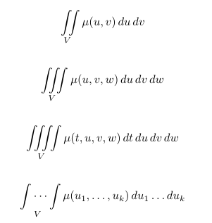
Multiple integrals

Slide 15
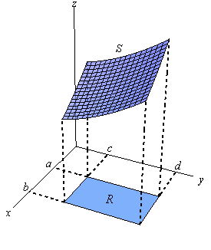
Multiple integrals

Slide 16
Moment of inertia
Moment of inertia is the mass property of a rigid body that determines the torque needed for a desired angular acceleration about an axis of rotation. Moment of inertia depends on the shape of the body and may be different around different axes of rotation. A larger moment of inertia around a given axis requires more torque to increase the rotation, or to stop the rotation, of a body about that axis. Moment of inertia depends on the amount and distribution of its mass, and can be found through the sum of moments of inertia of the masses making up the whole object, under the same conditions.

Slide 17
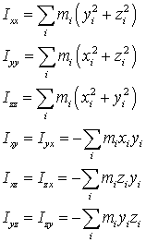
Moment of inertia

Slide 18
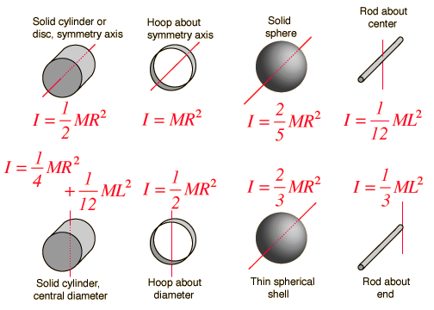
Moment of inertia

Slide 19
Kinetic energy of rotation and translation
The rotational energy or angular kinetic energy is the kinetic energy due to the rotation of an object and is part of its total kinetic energy.

Slide 20
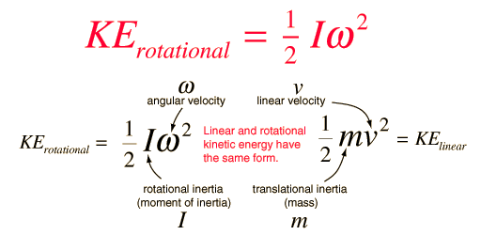
Kinetic energy of rotation

Slide 21
Improper integrals
an improper integral is the limit of a definite integral as an endpoint of the interval(s) of integration approaches either a specified real number or infinity.

Slide 22
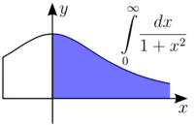
Improper integrals

Slide 23
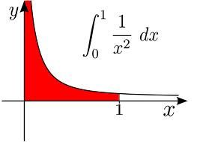
Improper integrals

Slide 24
Binomial distribution game

Slide 25
Equations integration:
Wave equation
Strange attractor
Heat equation
Diffusion equation

Slide 26
Series:
Binomial series
Taylor series

Slide 27
Cross product as a determinant

Slide 28
Minimum

Slide 29
Maximum

Slide 30
Convexity

Slide 31
Concavity

Slide 32
Inflection

Slide 33
Graphing functions

Slide 34
Polar coordinates
The polar coordinate system is a two-dimensional coordinate system in which each point on a plane is determined by a distance from a fixed point and an angle from a fixed direction.
The fixed point (analogous to the origin of a Cartesian system) is called the pole, and the ray from the pole in the fixed direction is the polar axis. The distance from the pole is called the radial coordinate or radius, and the angle is the angular coordinate, polar angle, or azimuth.

Slide 35
Curvature
curvature is any of a number of loosely related concepts in different areas of geometry. Intuitively, curvature is the amount by which a geometric object deviates from being flat, or straight in the case of a line, but this is defined in different ways depending on the context. There is a key distinction between extrinsic curvature, which is defined for objects embedded in another space (usually a Euclidean space) in a way that relates to the radius of curvature of circles that touch the object, and intrinsic curvature, which is defined at each point in a Riemannian manifold. This article deals primarily with the first concept.

Slide 36
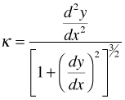
Curvature

Slide 37
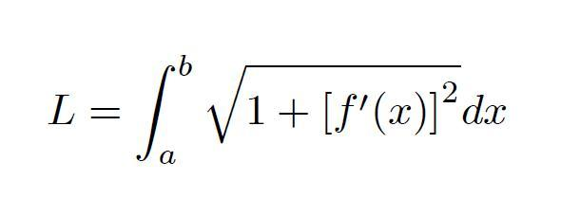
Curve length

Slide 38
Conic sections
A conic section (or just conic) is a curve obtained as the intersection of a cone (more precisely, a right circular conical surface) with a plane. In analytic geometry, a conic may be defined as a plane algebraic curve of degree 2. There are a number of other geometric definitions possible. One of the most useful, in that it involves only the plane, is that a conic consists of those points whose distances to some point, called a focus, and some line, called a directrix, are in a fixed ratio, called the eccentricity.

Slide 39
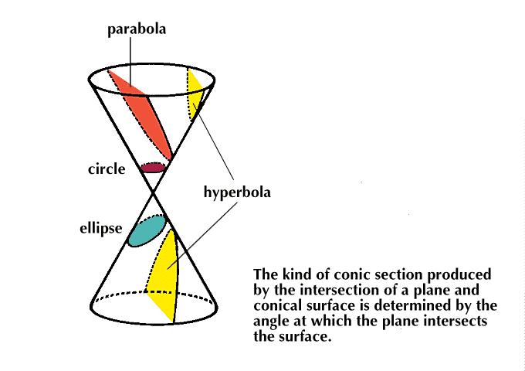
Conic sections

Slide 40
Quadric surface
Quadric surface, is any D-dimensional hypersurface in (D + 1)-dimensional space defined as the locus of zeros of a quadratic polynomial.

Slide 41
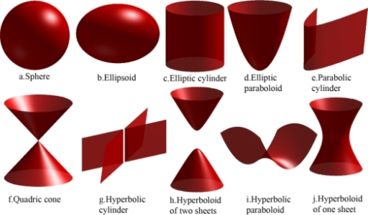
Quadric surface

Slide 42
Extremes of multivariate functions
The second partial derivative test is a method in multivariable calculus used to determine if a critical point of a function is a local minimum, maximum or saddle point.

Slide 43
Least squares

Slide 44
The principle of the least energy expenditure says that any natural system tries to get to a state with the smallest potential energy.

Slide 45
Comparison of translation and rotation:
- mass vs. moment of inertia,
- linear momentum vs. angular momentum,
- force vs. torque,
- linear kinetic energy vs. rotational kinetic energy,
- etc.

Slide 46
Relativistic momentum

Slide 47
Mass center vs. gravity center

Slide 48
Kinetic energy at high speeds

Slide 49
Binomial series to prove relativistic kinetic energy expression

Slide 50
Variation principles:
Least action principle
Least constraint principle
Operators
Hamiltonian
Lagrangian
Poisson brackets

Slide 51
Chain lines

Slide 52
Stability

Slide 53
Viscosity
The viscosity of a fluid is a measure of its resistance to gradual deformation by shear stress or tensile stress. For liquids, it corresponds to the informal concept of "thickness". For example, honey has a much higher viscosity than water.

Slide 54
Magnus effect
The Magnus effect is the commonly observed effect in which a spinning ball (or cylinder) curves away from its principal flight path. It is important in many ball sports. It affects spinning missiles, and has some engineering uses, for instance in the design of rotor ships and Flettner aeroplanes.

Slide 55
Explosions move the matter up due to the pressure difference

Slide 56
Waves

Slide 57
Earthquake

Slide 58
Echo

Slide 59
Damping

Slide 60
Mathematical pendulum

Slide 61
Physical pendulum

Slide 62
Standing waves
A standing wave – also known as a stationary wave – is a wave that remains in a constant position.

Slide 63
Doppler effect
The Doppler effect (or Doppler shift) is the change in frequency of a wave (or other periodic event) for an observer moving relative to its source. It is named after the Austrian physicist Christian Doppler, who proposed it in 1842 in Prague. It is commonly heard when a vehicle sounding a siren or horn approaches, passes, and recedes from an observer. Compared to the emitted frequency, the received frequency is higher during the approach, identical at the instant of passing by, and lower during the recession.

Slide 64
Interference
Interference is a phenomenon in which two waves superpose to form a resultant wave of greater or lower amplitude. Interference usually refers to the interaction of waves that are correlated or coherent with each other, either because they come from the same source or because they have the same or nearly the same frequency. Interference effects can be observed with all types of waves, for example, light, radio, acoustic, surface water waves or matter waves.

Slide 65
Diffraction
Diffraction refers to various phenomena which occur when a wave encounters an obstacle or a slit. In classical physics, the diffraction phenomenon is described as the interference of waves according to the Huygens Fresnel principle. These characteristic behaviors are exhibited when a wave encounters an obstacle or a slit that is comparable in size to its wavelength. Similar effects occur when a light wave travels through a medium with a varying refractive index, or when a sound wave travels through a medium with varying acoustic impedance. Diffraction occurs with all waves, including sound waves, water waves, and electromagnetic waves such as visible light, X-rays and radio waves.

Slide 66
Quantum protection of information due to the uncertainty principle

Slide 67
Irreversible deformations:
Plasticity,
creep,
viscosity

Slide 68
Links to thermodynamics:
Statistical mechanics
Irreversibility and conservation as the links between mechanics and thermodynamics
One way function is computer science is similar to the 2d Law of Thermodynamics
Mixing colors is easy but separating is almost impossible

Slide 69
Temperature,
pressure,
volume

Slide 70
Thermal expansion
Thermal expansion is the tendency of matter to change in volume in response to a change in temperature, through heat transfer.

Slide 71
Thermal stresses

Slide 72
Entropy
Entropy is a measure of the number of specific ways in which a thermodynamic system may be arranged, commonly understood as a measure of disorder. According to the second law of thermodynamics the entropy of an isolated system never decreases; such systems spontaneously evolve^{[further explanation needed]} towards thermodynamic equilibrium, the configuration with maximum entropy. Systems which are not isolated may decrease in entropy. Since entropy is a state function, the change in the entropy of a system is the same for any process going from a given initial state to a given final state, whether the process is reversible or irreversible. However irreversible processes increase the combined entropy of the system and its environment.

Slide 73
Avogadro’s number
The Avogadro constant (symbols: L, N_{A}) is defined as the number of constituent particles (usually atoms or molecules) per mole of a given substance, where the mole (abbreviation: mol) is one of the seven base units in the International System of Units (SI).

Slide 74
Ideal gas
An ideal gas is a theoretical gas composed of many randomly moving point particles that do not interact except when they collide elastically. The ideal gas concept is useful because it obeys the ideal gas law, a simplified equation of state, and is amenable to analysis under statistical mechanics. One mole of an ideal gas has a volume of 22.4 L at STP.

Slide 75
Distribution of speeds
Maxwell–Boltzmann distribution:
The Maxwell–Boltzmann distribution or Maxwell speed distribution describes particle speeds in idealized gases where the particles move freely inside a stationary container without interacting with one another, except for very brief collisions in which they exchange energy and momentum with each other or with their thermal environment. Particle in this context refers to gaseous atoms or molecules, and the system of particles is assumed to have reached thermodynamic equilibrium.

Slide 76
Phases changes
A phase transition is the transformation of a thermodynamic system from one phase or state of matter to another one by heat transfer. The term is most commonly used to describe transitions between solid, liquid and gaseous states of matter, and, in rare cases, plasma. A phase of a thermodynamic system and the states of matter have uniform physical properties. During a phase transition of a given medium certain properties of the medium change, often discontinuously, as a result of the change of some external condition, such as temperature, pressure, or others. For example, a liquid may become gas upon heating to the boiling point, resulting in an abrupt change in volume. The measurement of the external conditions at which the transformation occurs is termed the phase transition. Phase transitions are common in nature and used today in many technologies.

Slide 77
Vapor pressure and humidity
Humidity is the amount of water vapor in the air. Water vapor is the gaseous state of water and is invisible. Humidity indicates the likelihood of precipitation, dew, or fog. Higher humidity reduces the effectiveness of sweating in cooling the body by reducing the rate of evaporation of moisture from the skin. This effect is calculated in a heat index table or humidex, used during summer weather.
There are three main measurements of humidity: absolute, relative and specific. Absolute humidity is the water content of air. Relative humidity, expressed as a percent, measures the current absolute humidity relative to the maximum for that temperature. Specific humidity is a ratio of the water vapor content of the mixture to the total air content on a mass basis.

Slide 78
Boiling
Boiling is the rapid vaporization of a liquid, which occurs when a liquid is heated to its boiling point, the temperature at which the vapor pressure of the liquid is equal to the pressure exerted on the liquid by the surrounding environmental pressure.

Slide 79
Convection
Convection is the concerted, collective movement of groups or aggregates of molecules within fluids (e.g., liquids, gases) and rheids, either through advection or through diffusion or as a combination of both of them. Convection of mass cannot take place in solids, since neither bulk current flows nor significant diffusion can take place in solids. Diffusion of heat can take place in solids, but that is called heat conduction. Convection can be demonstrated by placing a heat source (e.g. a Bunsen burner) at the side of a glass full of a liquid, and observing the changes in temperature in the glass caused by the warmer fluid moving into cooler areas.

Slide 80
Conduction
Heat conduction (or thermal conduction) is the transfer of internal energy by microscopic diffusion and collisions of particles or quasi-particles within a body due to a temperature gradient. The microscopically diffusing and colliding objects include molecules, electrons, atoms, and phonons. They transfer disorganized microscopic kinetic and potential energy, which are jointly known as internal energy. Conduction can only take place within an object or material, or between two objects that are in direct or indirect contact with each other. Conduction takes place in all forms of ponderable matter, such as solids, liquids, gases and plasmas.

Slide 81
Evaporation
Evaporation is a type of vaporization of a liquid that occurs from the surface of a liquid into a gaseous phase that is not saturated with the evaporating substance. The other type of vaporization is boiling, which is characterized by bubbles of saturated vapor forming in the liquid phase. Steam produced in a boiler is another example of evaporation occurring in a saturated vapor phase. Evaporation that occurs directly from the solid phase below the melting point, as commonly observed with ice at or below freezing or moth crystals (napthalene or paradichlorobenzine), is called sublimation.

Slide 82
Laws of thermodynamics
The four laws of thermodynamics define fundamental physical quantities (temperature, energy, and entropy) that characterize thermodynamic systems. The laws describe how these quantities behave under various circumstances, and forbid certain phenomena (such as perpetual motion).

Slide 83
Laws of thermodynamics
The four laws of thermodynamics are:
Zeroth law of thermodynamics: If two systems are in thermal equilibrium separately, with a third system, they must be in thermal equilibrium with each other. This law helps define the notion of temperature.
First law of thermodynamics: Because energy is conserved, the internal energy of a system changes as heat flows in or out of it. Equivalently, perpetual motion machines of the first kind are impossible.
Second law of thermodynamics: The entropy of any isolated system never decreases. Such systems spontaneously evolve towards thermodynamic equilibrium — the state of maximum entropy of the system. Equivalently, perpetual motion machines of the second kind are impossible.
Third law of thermodynamics: The entropy of a system approaches a constant value as the temperature approaches absolute zero. With the exception of glasses the entropy of a system at absolute zero is typically close to zero, and is equal to the log of the multiplicity of the quantum ground state.

Slide 84
Irreversibly smashed cup

Slide 85
Heat engines
A heat engine is a system that converts heat or thermal energy to mechanical energy, which can then be used to do mechanical work.^{[1][2]} It does this by bringing a working substance from a higher state temperature to a lower state temperature. A heat "source" generates thermal energy that brings the working substance to the high temperature state. The working substance generates work in the "working body" of the engine while transferring heat to the colder "sink" until it reaches a low temperature state. During this process some of the thermal energy is converted into work by exploiting the properties of the working substance. The working substance can be any system with a non-zero heat capacity, but it usually is a gas or liquid.

Slide 86
Carnot engine
A Carnot heat engine is a hypothetical engine that operates on the reversible Carnot cycle. The basic model for this engine was developed by Nicolas Léonard Sadi Carnot in 1824. The Carnot engine model was graphically expanded upon by Benoît Paul Émile Clapeyron in 1834 and mathematically elaborated upon by Rudolf Clausius in 1857 from which the concept of entropy emerged.

Slide 87
Order to disorder

Slide 88
Time’s arrow
The arrow of time, or time's arrow, is a concept developed in 1927 by the British astronomer Arthur Eddington involving the "one-way direction" or "asymmetry" of time. This direction, which can be determined, according to Eddington, by studying the organization of atoms, molecules and bodies, might be drawn upon a four-dimensional relativistic map of the world ("a solid block of paper").

Slide 89
Statistical interpretation of entropy and Second Law

Slide 90
Brownian motion
Brownian motion is the random motion of particles suspended in a fluid (a liquid or a gas) resulting from their collision with the quick atoms or molecules in the gas or liquid. The term "Brownian motion" can also refer to the mathematical model used to describe such random movements, which is often called a particle theory.

Slide 91
Diffusion
Diffusion is the net movement of a substance (e.g., an atom, ion or molecule) from a region of high concentration to a region of low concentration. This is also referred to as the movement of a substance down a concentration gradient. A gradient is the change in the value of a quantity (e.g., concentration, pressure, temperature) with the change in another variable (e.g., distance). For example, a change in concentration over a distance is called a concentration gradient, a change in pressure over a distance is called a pressure gradient, and a change in temperature over a distance is a called a temperature gradient.

Slide 92
Computing thermodynamics

Slide 93
The principle of the least energy expenditure says that any natural system tries to get to a state with the smallest potential energy.

Slide 94
Debate
Debate competitions are 10% of our scores.
Register today
Use your calculus knowledge in the debate

