Slide 1
5 Lecture in calculus
Exponent
Logarithm
Curves theory
Graphing functions
Polar coordinates
Mid-Term Exam preparation

Slide 2
Mid-Term Exam preparation
studying mostly numbers, graphs, limits, continuity, derivative and integral

Slide 3
Exponent: base change, derivative, integral

Slide 4
Logarithm: base change, derivative, integral

Slide 5
Base change

Slide 6
Polar coordinate system
The polar coordinate system is a two-dimensional coordinate system in which each point on a plane is determined by a distance from a fixed point and an angle from a fixed direction.
The fixed point (analogous to the origin of a Cartesian system) is called the pole, and the ray from the pole in the fixed direction is the polar axis. The distance from the pole is called the radial coordinate or radius, and the angle is the angular coordinate, polar angle, or azimuth.

Slide 7
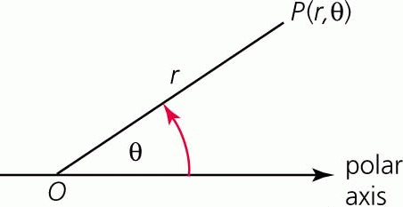
Polar coordinate system

Slide 8
Curves theory

Slide 9
Sign of curvature
Convexity
Concavity

Slide 10
Inflection
An inflection point, point of inflection, flex, or inflection (inflexion) is a point on a curve at which the curve changes from being concave (concave downward) to convex (concave upward), or vice versa.
A point where the curvature vanishes but does not change sign is sometimes called a point of undulation or undulation point.
In algebraic geometry an inflection point is defined slightly more generally, as a point where the tangent meets the curve to order at least 3, and an undulation point or hyperflex is defined as a point where the tangent meets the curve to order at least 4.

Slide 11
Curvature
Limits of curvature of parabola, hyperbola

Slide 12
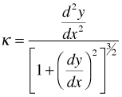
Curvature

Slide 13
Curve length

Slide 14
Graphing functions
Cartesian coordinates
Polar coordinates

Slide 15
Linear function
Slope
Intercept
Parallel lines
Perpendicular lines

Slide 16
Parametric equation
Parametric equations of a curve express the coordinates of the points of the curve as functions of a variable, called a parameter.

Slide 17
Parametric equation

Slide 18
Number theory
Complex roots, powers

Slide 19
Polar coordinates are used to represent complex numbers

Slide 20
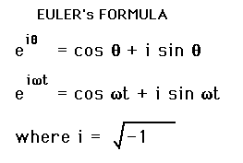

Slide 21
Complex numbers

Slide 22
Complex numbers (continued)

Slide 23
(continued) Complex numbers

Slide 24
Complex numbers (continued)

Slide 26
Cross product as a determinant

Slide 27
Surfaces theory
Planes (Linear surfaces)
Quadric surfaces
Ellipsoid of inertia
Surface area of a body of revolution

Slide 28
Programming
Linear programming
Non-linear programming

Slide 29
Interest
Simple interest
Compound interest

Slide 30
Logistical equation

Slide 31
Predator-prey model

Slide 32
Debate competitions
Debate competitions are 5% of our scores.
Attend the debate competition these Tuesday and Wednesday
Use your calculus knowledge in the debate

