Slide 1
6 Lecture in calculus
Absolute value
Inequalities
Trigonometry
Graphs
Asymptotes
Limits
Continuity
Derivative
Integral
Vectors
Series
Proofs
Complex numbers
Stretches
Translation
Rotation
Mid-Term Exam preparation

Slide 2
Absolute value
The absolute value (or modulus) |x| of a real number x is the non-negative value of x without regard to its sign.

Slide 3
Absolute value (continued)

Slide 4
Inequalities
Inequalities are governed by the following properties. All of these properties also hold if all of the non-strict inequalities (≤ and ≥) are replaced by their corresponding strict inequalities (< and >) and (in the case of applying a function) monotonic functions are limited to strictly monotonic functions.

Slide 5
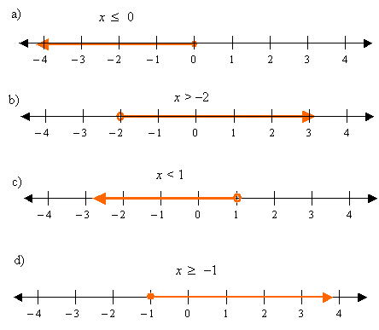
Inequalities (continued)

Slide 6
Asymptotes
An asymptote (/ˈæsɪmptoʊt/) of a curve is a line such that the distance between the curve and the line approaches zero as they tend to infinity. Some sources include the requirement that the curve may not cross the line infinitely often, but this is unusual for modern authors. In some contexts, such as algebraic geometry, an asymptote is defined as a line which is tangent to a curve at infinity.

Slide 7
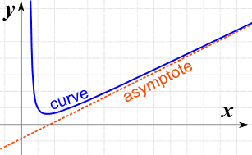
Asymptotes (continued)

Slide 8
Trigonometry
Trigonometry (from Greek trigōnon, "triangle" and metron, "measure") is a branch of mathematics that studies relationships involving lengths and angles of triangles. The field emerged during the 3rd century BC from applications of geometry to astronomical studies.

Slide 9
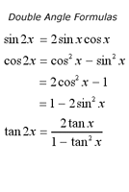
Trigonometry (continued)

Slide 10
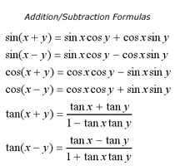
(continued) Trigonometry

Slide 11
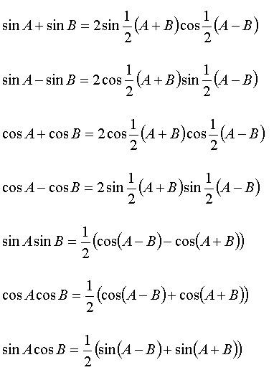
Trigonometry (continued)

Slide 12
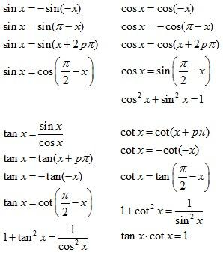
(continued) Trigonometry

Slide 13
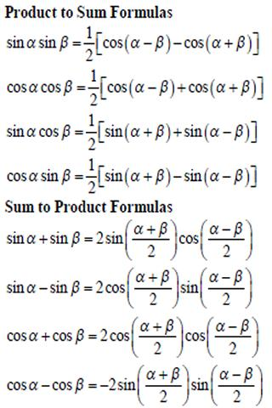
Trigonometry (continued)

Slide 14
Dot product
The dot product, or scalar product (or sometimes inner product in the context of Euclidean space), is an algebraic operation that takes two equal-length sequences of numbers (usually coordinate vectors) and returns a single number. This operation can be defined either algebraically or geometrically. Algebraically, it is the sum of the products of the corresponding entries of the two sequences of numbers. Geometrically, it is the product of the Euclidean magnitudes of the two vectors and the cosine of the angle between them. The name "dot product" is derived from the centered dot " · " that is often used to designate this operation; the alternative name "scalar product" emphasizes the scalar (rather than vectorial) nature of the result.
In three-dimensional space, the dot product contrasts with the cross product of two vectors, which produces a pseudovector as the result. The dot product is directly related to the cosine of the angle between two vectors in Euclidean space of any number of dimensions.

Slide 15
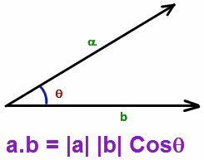
Dot product (continued)

Slide 16
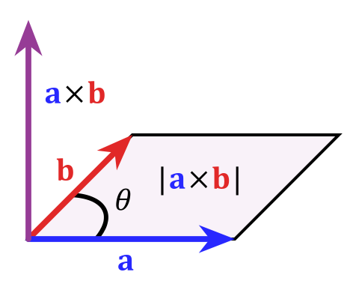
Cross product

Slide 17
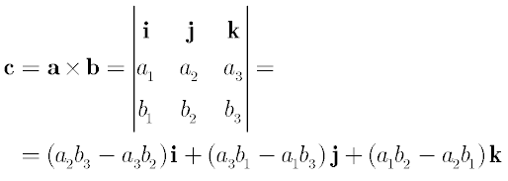
Cross product (continued)

Slide 18
Taylor series
A Taylor series is a representation of a function as an infinite sum of terms that are calculated from the values of the function's derivatives at a single point.
The concept of a Taylor series was discovered by the Scottish mathematician James Gregory and formally introduced by the English mathematician Brook Taylor in 1715. If the Taylor series is centered at zero, then that series is also called a Maclaurin series, named after the Scottish mathematician Colin Maclaurin, who made extensive use of this special case of Taylor series in the 18th century.
It is common practice to approximate a function by using a finite number of terms of its Taylor series. Taylor's theorem gives quantitative estimates on the error in this approximation. Any finite number of initial terms of the Taylor series of a function is called a Taylor polynomial. The Taylor series of a function is the limit of that function's Taylor polynomials, provided that the limit exists. A function may not be equal to its Taylor series, even if its Taylor series converges at every point. A function that is equal to its Taylor series in an open interval (or a disc in the complex plane) is known as an analytic function in that interval.

Slide 19
Taylor series (continued)

Slide 20
Mid-Term Exam preparation
To prepare to the Mid-Term Exam:
Study the class notes, solve all the problem sets, solve all the relevant problems from the textbooks, visit the web-sites, study the solutions, watch the videos, and meet me if you have any questions.

